Slide 1
IT Association of Slovakia
& IT sector in Slovakia
Joint Study programmes
Mario Lelovsky
First Vice president
IT Association of Slovakia

Slide 2


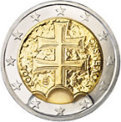
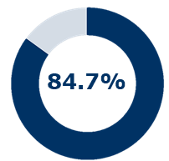

THRIVING
TATRA TIGER
EURO €
STABILITY & PREDICTABILITY
STRONG EXPORT
4TH PLACE IN EUROPE
STEADY GROWTH
ONE OF THE FASTEST IN THE REGION
BALANCED FINANCE
ONE OF THE BEST CREDIT RATINGS
Highlighted countries are Eurozone members
Notes:
Last update: 2017
EURO
One of a few in CEE
Euro implementation impact:
Limitation of Foreign Exchange Risk
Lowering Transaction Costs
Growth in Foreign Trade
Increased Economic & Financial Stability
Favorable conditions for long-term business decisions
EXPORT
4th in Europe in the export of goods & services to GDP: 93.8% (2016) (after Luxembourg, Malta, Ireland)
6th worldwide in export of goods and services to GDP index in 2014 – after Hong Kong, Singapore, Maldives, UAE, Macao (it does not mention Lux, Malta, Ireland)
15th Out of 75 countries in the OPEN MARKETS INDEX (2015) by the International Chamber of Commerce
GROWTH
European Commission, European Economic Forecast Spring 2017 (5/2017)
3,3% 2016, 3,0% 2017, 3,6% 2018
Fastest growth in Euro Zone: Average 2005-2016 3,3%
(LV 2,3; LT 2,0; EURO 1,8)
INDEBTNESS
THIRD LOWEST INDEBTEDNESS (PUBLIC DEBT) IN EUROZONE – 51,9% GDP

Slide 3

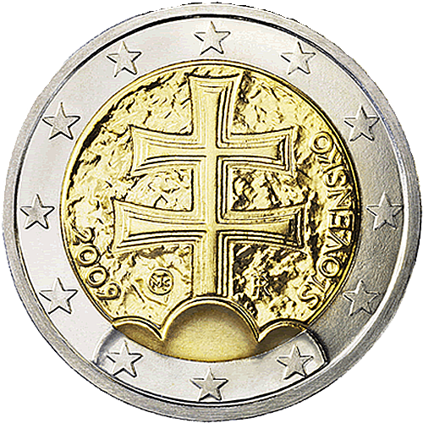
EURO CURRENCY
AS ONE OF A FEW IN CEE
EUROZONE MEMBER
SINCE 2009
Impact on business:
  Limitation of Foreign Exchange Risk
  Lowering Transaction Costs
  Growth in Foreign Trade
  Increased Economic & Financial Stability
Favorable conditions for long-term business decisions
Notes:
Last update: 10.3.2016

Slide 4

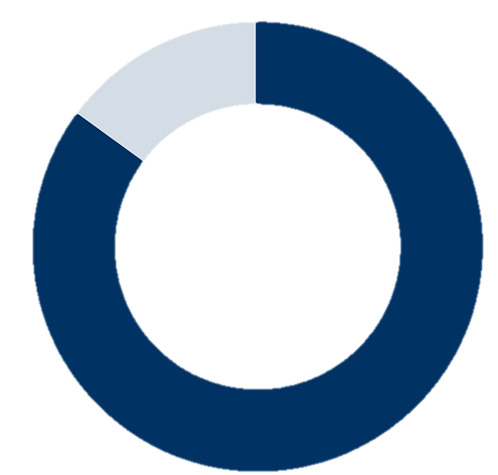
STRONG EXPORT
ONE OF THE MOST OPEN ECONOMIES
84.7%
Export of goods to gdp ratio
1st place in Europe
4th
in Europe in the export of goods & services to GDP: 96.3% (2017)
12th
Out of 75 countries in the OPEN MARKETS INDEX
(2017) by the International Chamber of Commerce
Source: Eurostat (2016), International Chamber of Commerce (2017)
Notes:
Last update: 9.7.2018
Source:
Eurostat, Exports of goods and services in % of GDP (5/2017): http://ec.europa.eu/eurostat/tgm/table.do;jsessionid=AvXqMaArHP9A6W63CSEZnzi3nQSB4pPgwsiJHdy9-2mn1gjehywV!-503751436?tab=table&plugin=1&language=en&pcode=tet00003
Eurostat, GDP and main components (output, expenditure and income (5/2017): https://www.google.sk/url?sa=t&rct=j&q=&esrc=s&source=web&cd=1&cad=rja&uact=8&ved=0ahUKEwig8pOSn_LTAhWEiRoKHR-0ClEQFgglMAA&url=http%3A%2F%2Fec.europa.eu%2Feurostat%2Fproduct%3Fmode%3Dview%26code%3Dnama_10_gdp&usg=AFQjCNFoQd2uFT-LIQMoZd_bRLMT1MwADA&sig2=xysRAwaXOTKWSCNw8MuXmg
ICC OPEN MARKETS INDEX, 2017: https://iccwbo.org/publication/icc-open-markets-index-2017/
Notes:
Export of goods to GDP ratio: percentualne vyjadrenie, pomer export k HDP v trhovych cenach (source: Eurostat), SR: 84,7%
Export of Goods+Services to GDP
in 2017 Slovakia takes 4th

Slide 5
BASIC MACROECONOMIC DATA
SOUND ECONOMIC STABILITY
4.2%
4.2%
4.1%
FASTEST AVERAGE ANNUAL GROWTH IN %
among CEE EUROZONE countries (2008-2017)
3.5%
2.45
3.1%
3.2%
SLOVAKIA
2.8%
1.47
LITHUANIA
ESTONIA
0.92
0.68
SLOVENIA
LATVIA
0.26
0.64
EURO AREA
HEALTHY & SUSTAINABLE GROWTH
One of the lowest indebtedness in EUROZONE
Source: GDP: European Commission, European Economic Forecast Winter 2019;
Notes:
Last update: 20.3.2019
Source:
European Commission, European Economic Forecast Winter 2018 (2/2018):
https://ec.europa.eu/info/business-economy-euro/economic-performance-and-forecasts/economic-forecasts/winter-2018-economic-forecast_en
Notes:
The IMF projects real GDP growth for Slovakia at 3.35% in 2016, 3.43% in 2017 and 3.4% in 2018. Get more details about the IMF forecast here.
The OECD forecast points to 3.43% in 2016 and 3.48% in 2017. Get more details about the OECD forecast here.
The EU Commission assumes GDP growth rates at 3.19% in 2016 and 3.27% in 2017. Get more details about the EU Commission forecast here.

Slide 6
About ITAS
IT Association of Slovakia (ITAS) is the largest association uniting all important Slovak and international IT/ICT companies in Slovakia
Founded in 1999
Today it represents more than 100 members (80% of ICT market) from private IT/ICT sector
Business covered by members: Software development, IT services incl. outsourcing, banking IT services, HW/SW distribution, Telecommunication, Education, Research and Development
Companies represented by ITAS employ 35 000 people
ITAS represents Slovakia in DigitalEurope

Slide 7























































































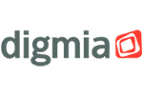















Slide 8
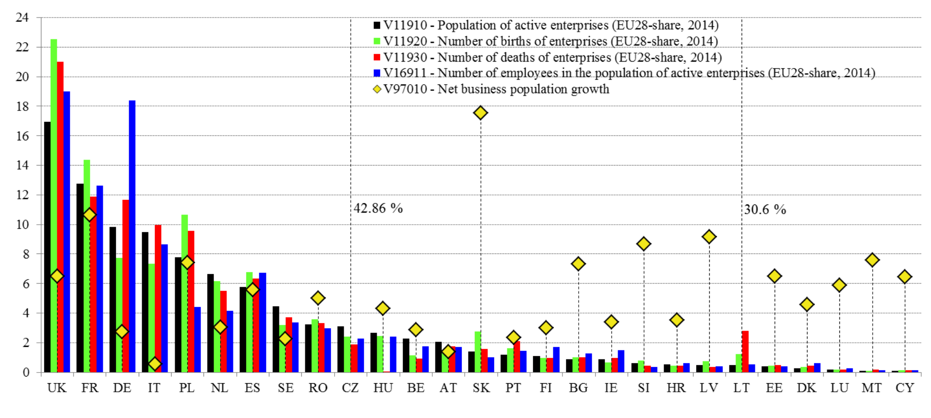
Member States by their shares (%) of the EU’s active ICT enterprises in 2014 (by Eurostat)
In 2014, Slovakia had 3rd highest Net business growth of ICT enterprises in EU

Slide 9
Digital environment and ICT jobs in Slovakia
There are about 55 000 ICT experts in Slovakia and currently there is a lack of 10 000 them.
We expect another 5 000 new open positions till 2020 in ICT jobs out of which probably 15 - 20 000 positions stay vacant as the processes of digital transformation will speed up.
Average salary of IT specialist is 2000EUR, programmers > 2500, senior experts 3500+
IT specialists are required in ICT and banking sectors mostly

Slide 10
Digital Skills and Jobs Coalition initiative EU
The Coalition tackles the need for digital skills of four broad groups:
Digital skills for all – developing digital skills to enable all citizens to be active in our digital society
Digital skills for the labour force – developing digital skills for the digital economy, e.g. upskilling and reskilling workers, jobseekers; actions on career advice and guidance
Digital skills for ICT professionals – developing high level digital skills for ICT professionals in all industry sectors
Digital skills in education – transforming teaching and learning of digital skills in a lifelong learning perspective, including the training of teacher

Slide 12
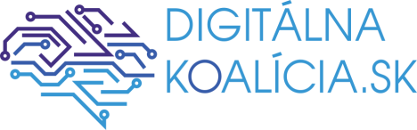
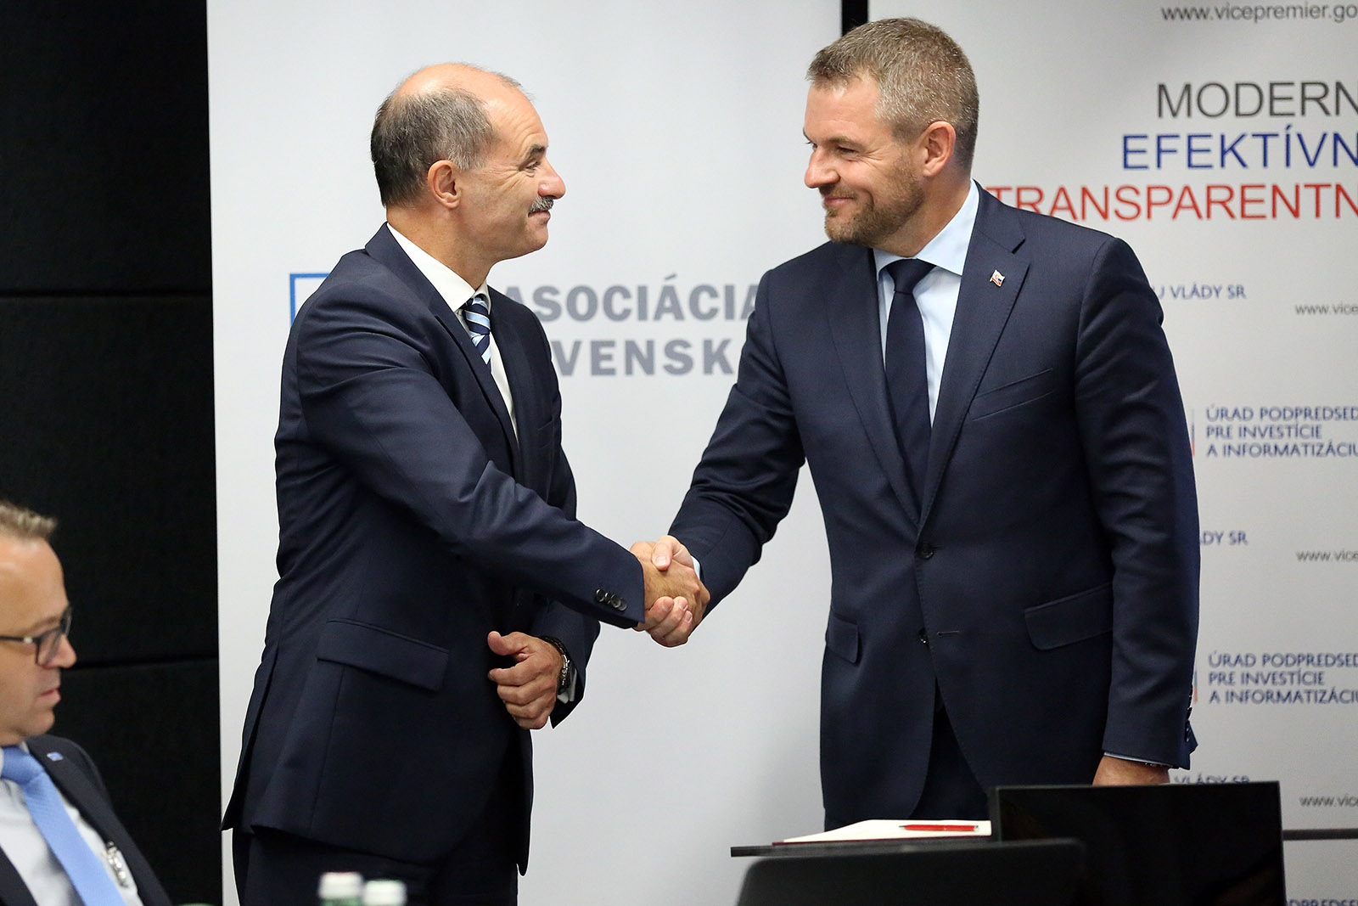
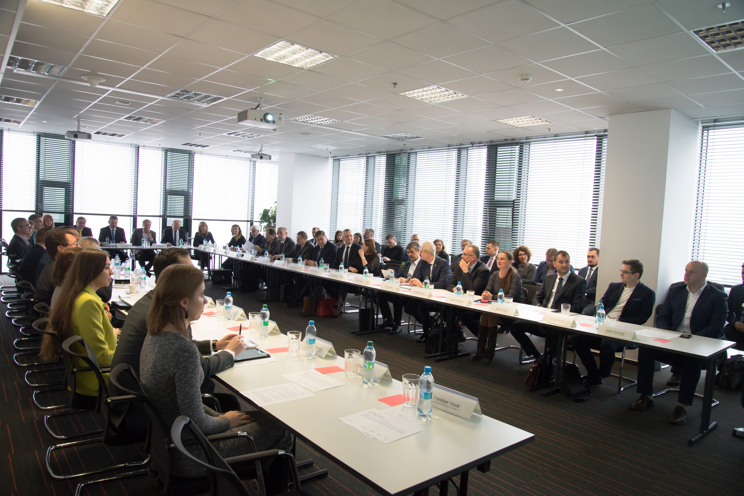
Slovak National Digital Coalition
ITAS initiated and coordinates Slovak Coalition for Digital Skills and Jobs together with Office of Vice Prime minister for Investment and Digitisation with the support of Prime Minister of Slovakia, Founded in sept. 2017
There were 21 founding members including state ministries, academia institutions, state agencies, IT and Telco companies, municipalities, employer’s and trade union’s associations,…. presenting 90 pledges

Slide 13
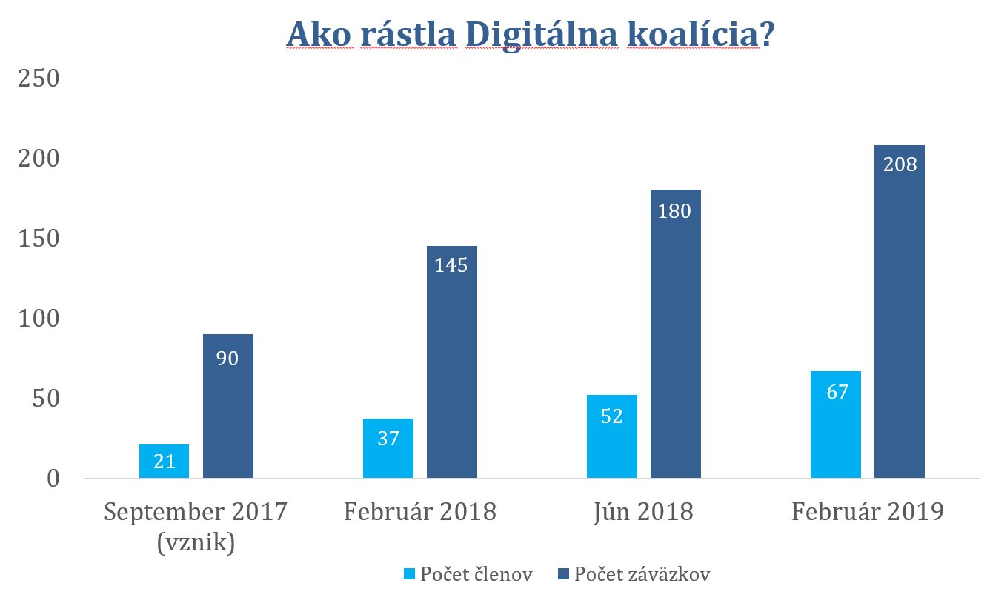
Status of the Digital Coalition 14.3.2019

Slide 14
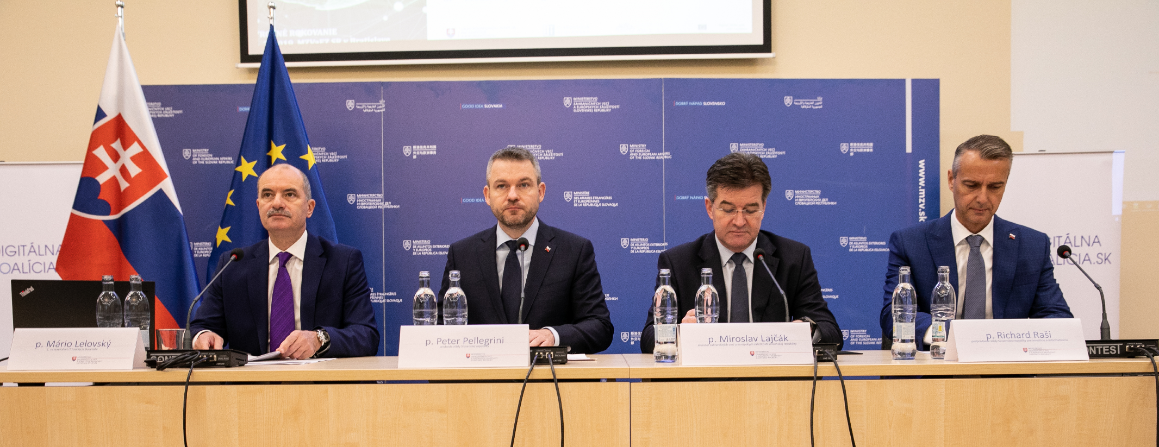
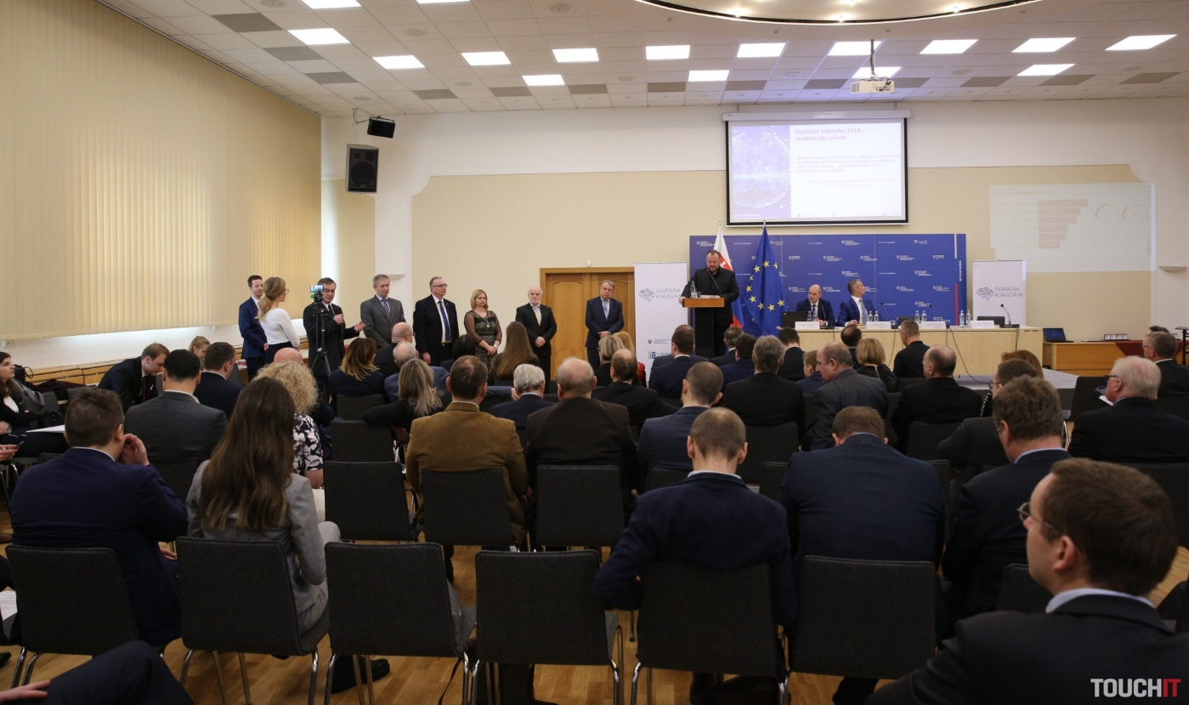
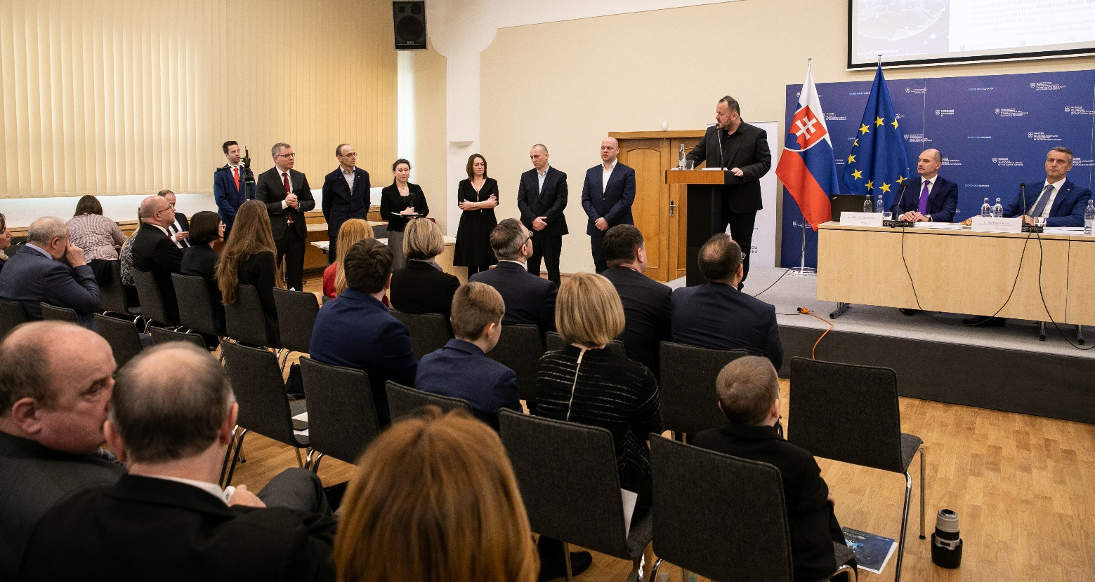

Slide 15
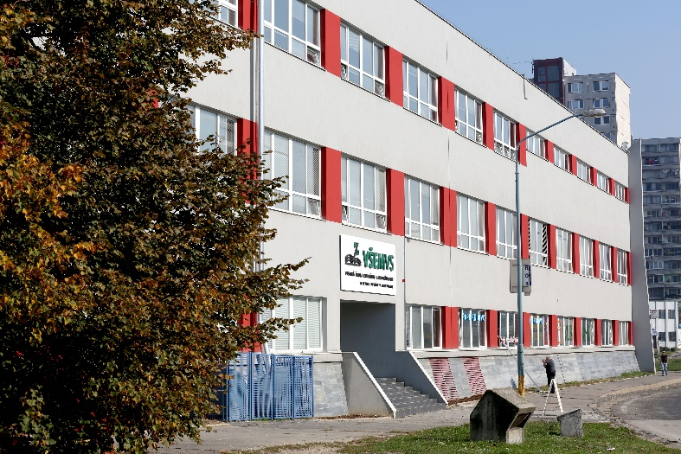
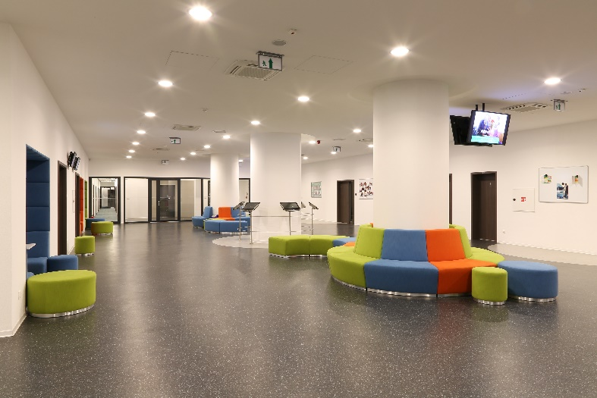
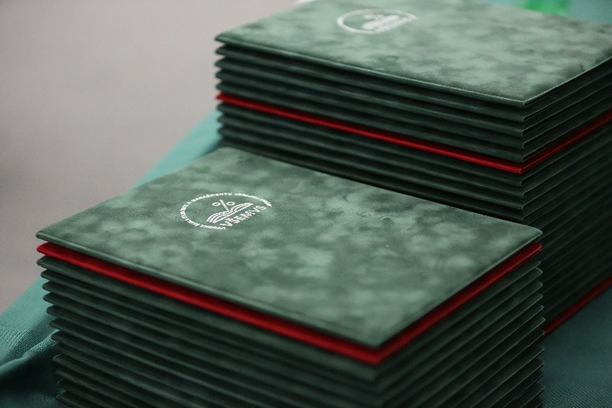
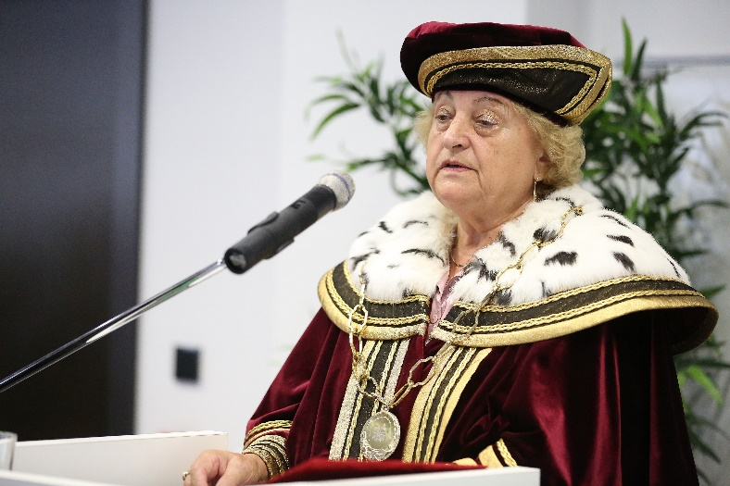
„Business Analytics and Information Systems in Entrepreneurship“
Double Degree Master Study Program
at VŠEMvs and EUSK
for Ukrainan IT students
with employment contract guarantee in Slovakia

Slide 16
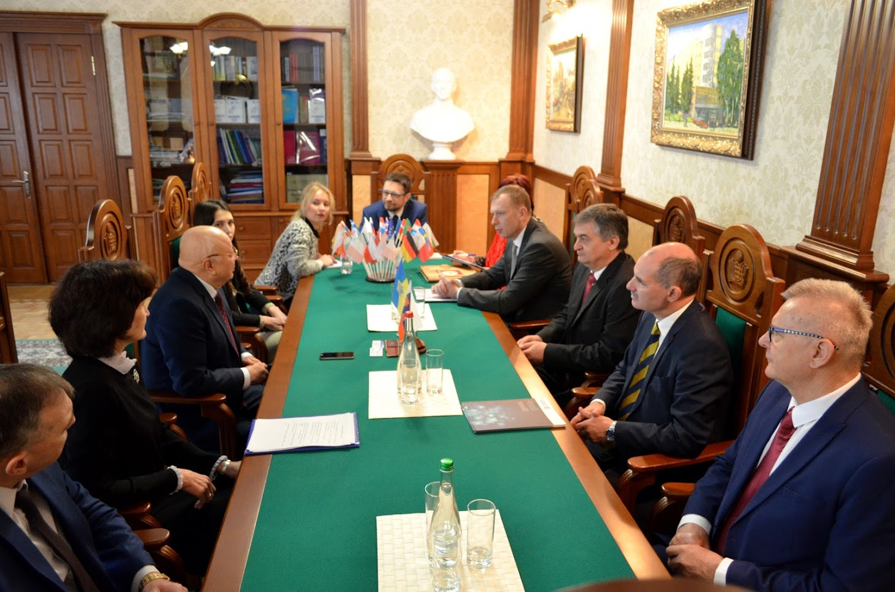
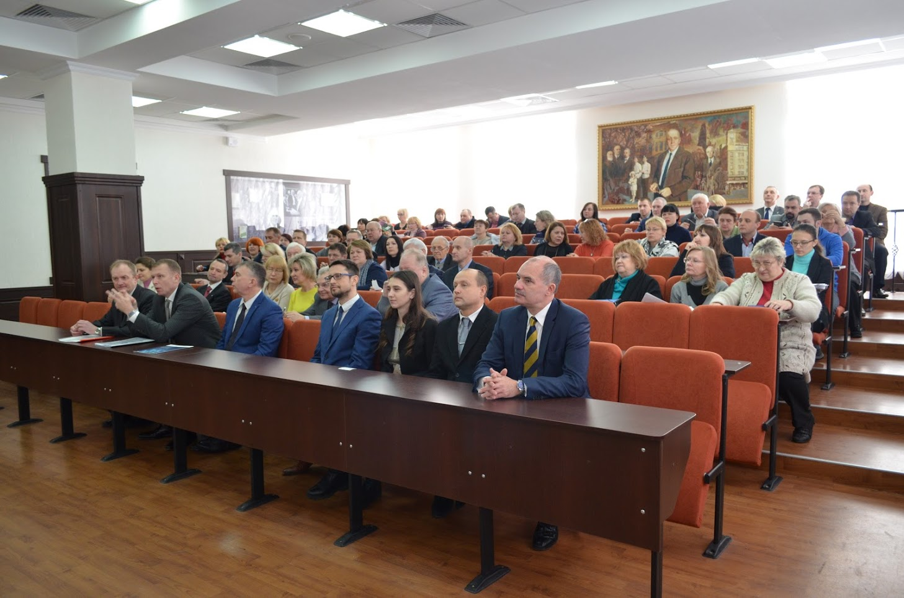
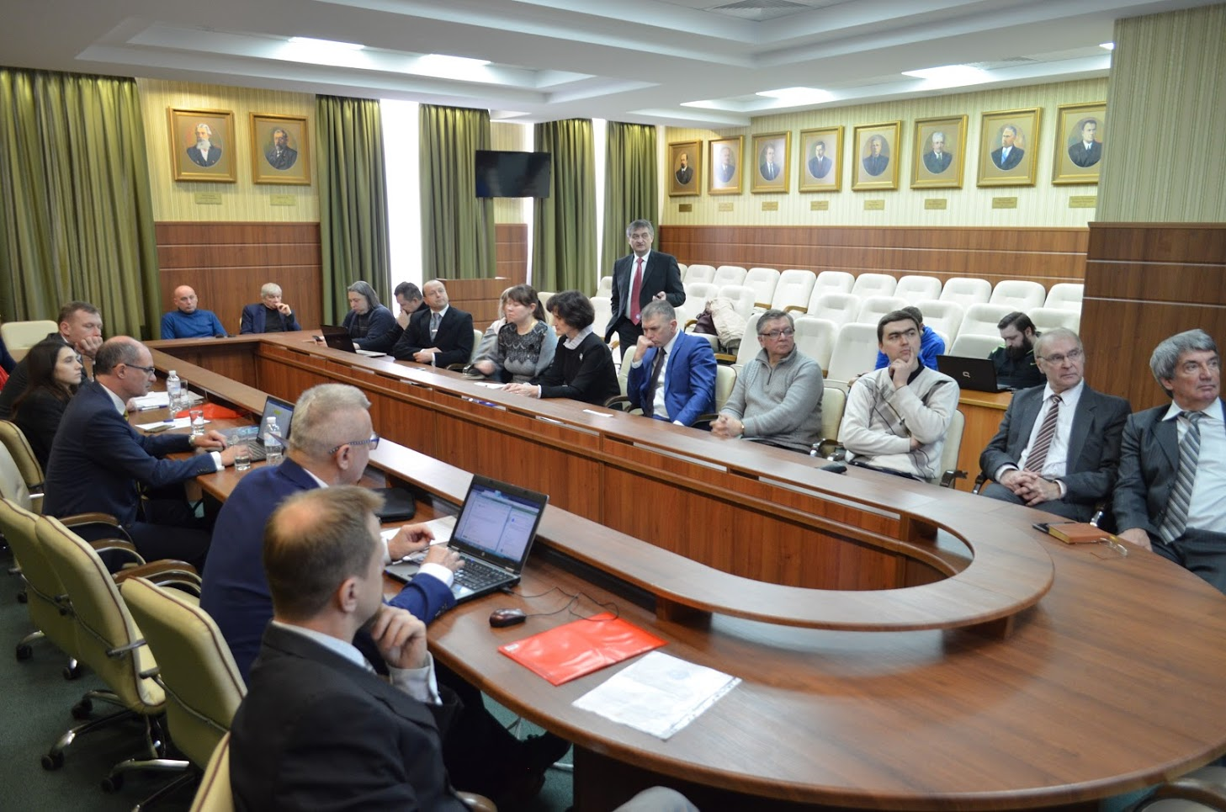
Visit of the university
in Kharkiv in 2018

Slide 17
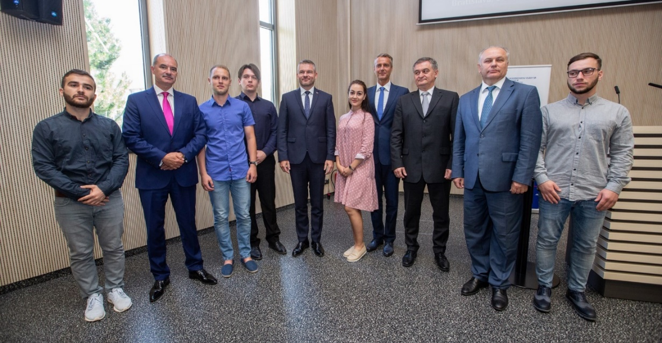
First students of the Common study programme invited by the Prime Minister Pellegrini

Slide 18
Partners of the Joint Study programme
Partners of the project are precisely selected among members of the IT Association of Slovakia, American Chamber of Commerce and Slovak Banking Association
Partners are the most valuable companies and corporates in Slovakia
Selection of practices and jobs include programmers / software developers, data analysts, IT system specialists, SW architects and project managers
Students will get to know to company during summer practice (June – August 10 weeks) and there will be a mentor and project manager dedicated at each of the company for the students and the project
Students will be included into existing project teams of companies
Actual Job offers of partners are available on http://www.amcham.sk/work-in-slovakia-good-idea

Slide 19
Partners of the project
AT&T
DELL
IBM
Slovenská sporiteľňa
Tatrabanka
Prvá stavebná sporiteľňa
Asseco Solutions
Atos
QBSW
LL Consulting
Soitron
T-Systems
International corporations, large size, SW development, outsourcing of services, shared services centres
Most prominent representatives of financial and banking sector in Slovakia, members of international banking chains
Successfull IT and software development Slovak companies with international business interactions

Slide 20

AT&T
AT&T is one of the largest telecommunications companies in the world.
It is a leader in providing services to large business customers, including multinational companies in six continents.
We help them increase productivity and look for new business opportunities.
We enable multinationals to manage emerging trends: mobility, cloud use and global expansion.
AT&T is a global company that began operations in Slovakia in 1999 to support international customers in Europe, the Middle East and Africa.
In Slovakia, we opened four centers - three in Bratislava and one in Košice.
Activity Area: Shared Service Centers, ICT services
Working time on the Slovak market: more than 10 years
Number of people employed by the company in Slovakia: > 4000 employees

Slide 21

DELL
Dell has been operating in Slovakia for 15 years as a global business center
providing a wide range of global IT, finance, marketing, sales,
technical support and enterprise operations support globally.
In finance, Dell Bratislava is one of the company's largest financial centers
in the world.
Activity Area: Shared Service Centers, ICT services
Working time on the Slovak market: more than 10 years
Number of people employed by the company in Slovakia: > 2000 employees

Slide 22

IBM
IBM is one of the largest IT companies in the world and has been serving clients for more than 100 years under the name International Business Machines.
It operates worldwide in over 160 countries worldwide.
IBM's mission is to use integrated, flexible, and efficient solutions to help its
customers reduce their costs and increase their market competitiveness.
Activity Area: Shared Service Centers, ICT services
Working time on the Slovak market: over 25 years
The number of people employed by the company in Slovakia: > 5,000 employees

Slide 23

Slovenská sporiteľňa
We are the bank with the longest tradition of savings in Slovakia.
Our roots date back to the 19th century.
We strive to create a working environment in which people believe
and we believe them. In addition to the benefits, we invest in the support
of corporate culture and modern offices.
The result of our endeavor is the title of the The Best employer three times
in a row and a number of stories of our colleagues who, thanks to our
trust and support, being able to support our clients
Field of activity: Banking, Finance, IT and Insurance
Working time on the Slovak market: over 25 years
Number of people employed by the company in Slovakia: > 4000 employees

Slide 24

Tatra Banka
First time ever: according to the renowned magazine, Global Finance, as a bank we have the best online products offerings in the whole world and Face Biometry contributed to this to a large extent.
Global Finance awarded Tatra banka the award of The World’s Best Digital Bank 2018 in the category of The World’s Best Online Deposit, Credit and Investment Product Offerings. The jury mainly acknowledged our innovative approach in online granting loans and accounts to the new clients and broad range of online products and services for the existing clients of the bank.
Field of activity: Banking, Finance, IT and Insurance
Working time on the Slovak market: over 25 years
Number of people employed by the company in Slovakia: > 3000 employees

Slide 25

ASSECO SOLUTIONS
Asseco Solutions, a. s. is part of the multinational group Asseco Solutions, one
the most important producer of information systems on the European market.
The product portfolio includes the development and implementation
of information systems for organizations
of all sizes in their various fields of operation, such as manufacturing,
trade or services, public administration, accommodation and catering facilities.
All products are complemented by a wide range of services and partner programs.
Field of activity: IT and telecommunications
Working time on the Slovak market: over 25 years
Number of people employed by the company in Slovakia: 51-250 employees

Slide 26

ATOS
With around 100,000 employees in 73 countries and an annual turnover of EUR 12 billion, Atos is a global leader in digital transformation. Atos believes that bringing people, business and technology together is the right step forward and will remain a trusted partner that empowers its clients with digital empowerment.
Atos is a European unit in Big Data, Cyber ​​Security, Digital Workplace. It provides cloud services, infrastructure and data services as well as transaction services through the Worldline.
Area of ​​activity: IT and telecommunications
Working time on the Slovak market: 8 years
Number of people employed by the company in Slovakia: 320 employees

Slide 27

QBSW
We are a software house - QBSW, a.s.
The name of our company comes from the English
"Quality Business SoftWare", which symbolizes our focus.
We are engaged in the development of IT applications according to the
requirements of our customers.
We deliver comprehensive solutions in the area of ​​analysis, design, creation and integration of information systems.
We focus on developing customized software solutions, supplying information
systems for public and corporate finance management, developing mobile and internet applications and IT consulting & outsourcing.
Field of activity: IT and telecommunications
Working time on the Slovak market: more than 10 years
Number of people employed by the company in Slovakia: >100 employees

Slide 28

SOITRON
Our story began 27 years ago when four young IT technology enthusiasts
decided to start Tronet. Back then, however, they felt that, thanks to their competence, insight and creativity, along with their clients' ability to understand their business, they could innovate and advance their IT projects. In 2005, becoming the leader in Slovakia not only as a system integrator, but also as an IT outsourcing service provider. With offices in seven countries, including the Czech Republic, Poland, Bulgaria, Romania, Turkey and the UK, Soitron is today the leader in introducing new technologies and innovative solutions in infrastructure, Unified Communications, contact centers, security, network services, applications, IT services and IT Outsourcing.
Field of activity: IT and telecommunications
Working time on the Slovak market: more than 20 years
The number of people the company employs : >400 employees

Slide 29

T-Systems
T-Systems Slovakia was established in Slovakia in 2006 to provide information
and communication (ICT) outsourcing services to global corporate clients
of Deutsche Telekom AG.
The company has been operating exclusively in Košice since its inception.
It was established as a subsidiary of T-Systems International GmbH, which
is headquartered in Germany and belongs to the global group Deutsche Telekom AG.
Field of activity: IT and telecommunications
Working time on the Slovak market: more than 10 years
Number of people employed by the company in Slovakia: > 4000 employees

Slide 30
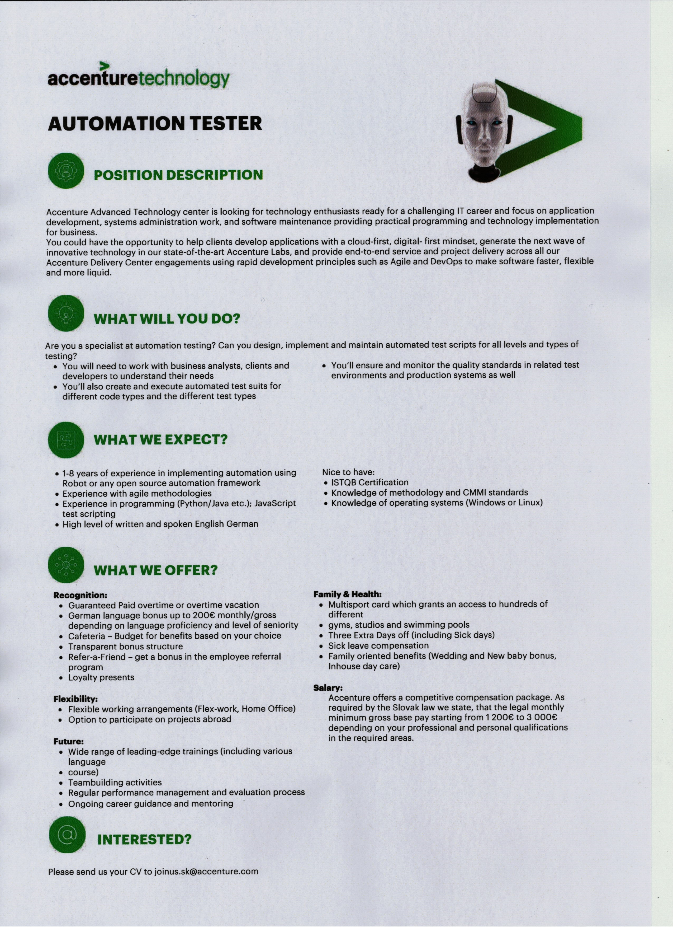
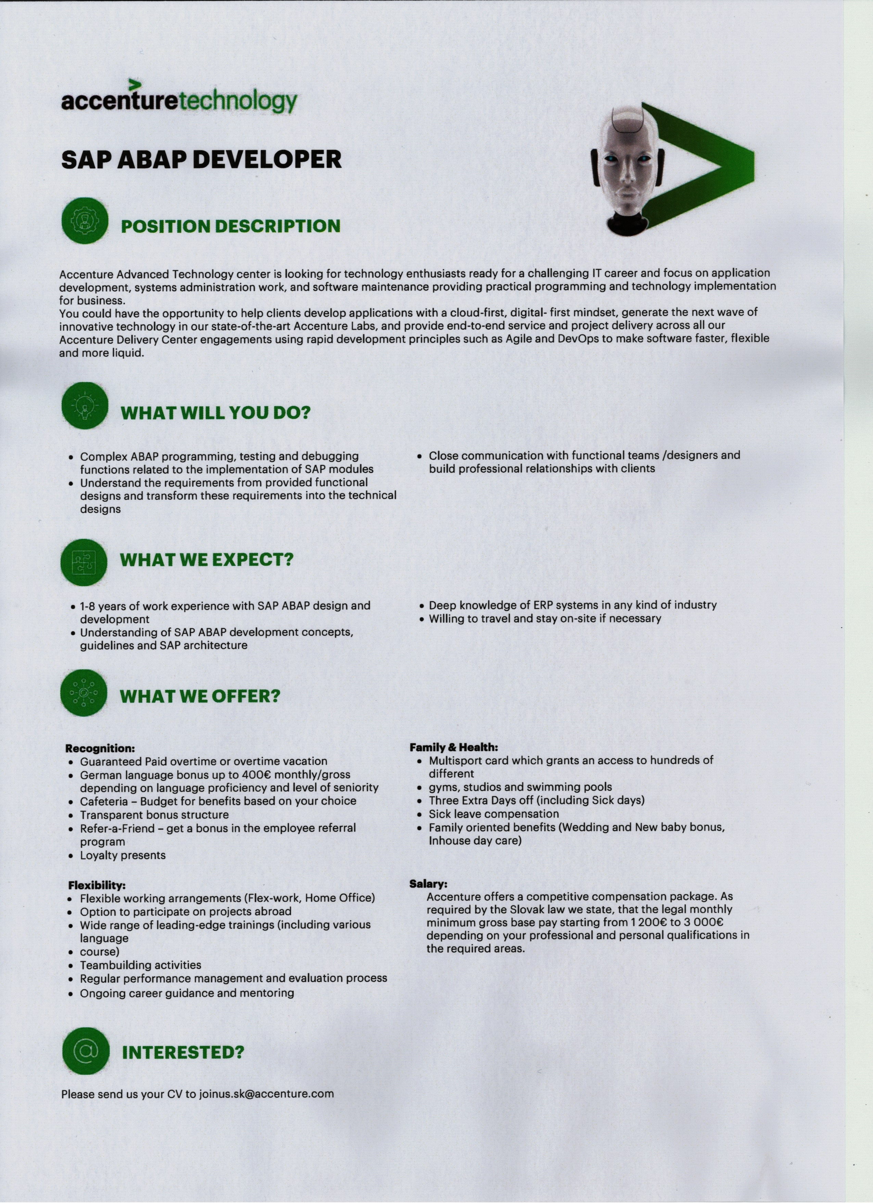
Job offers

Slide 31
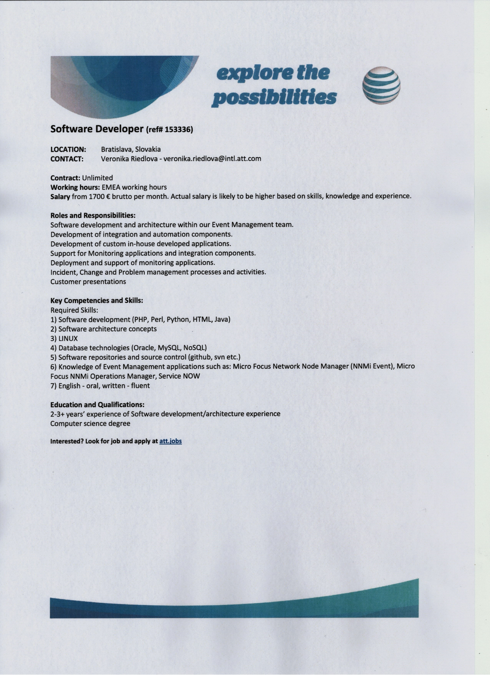
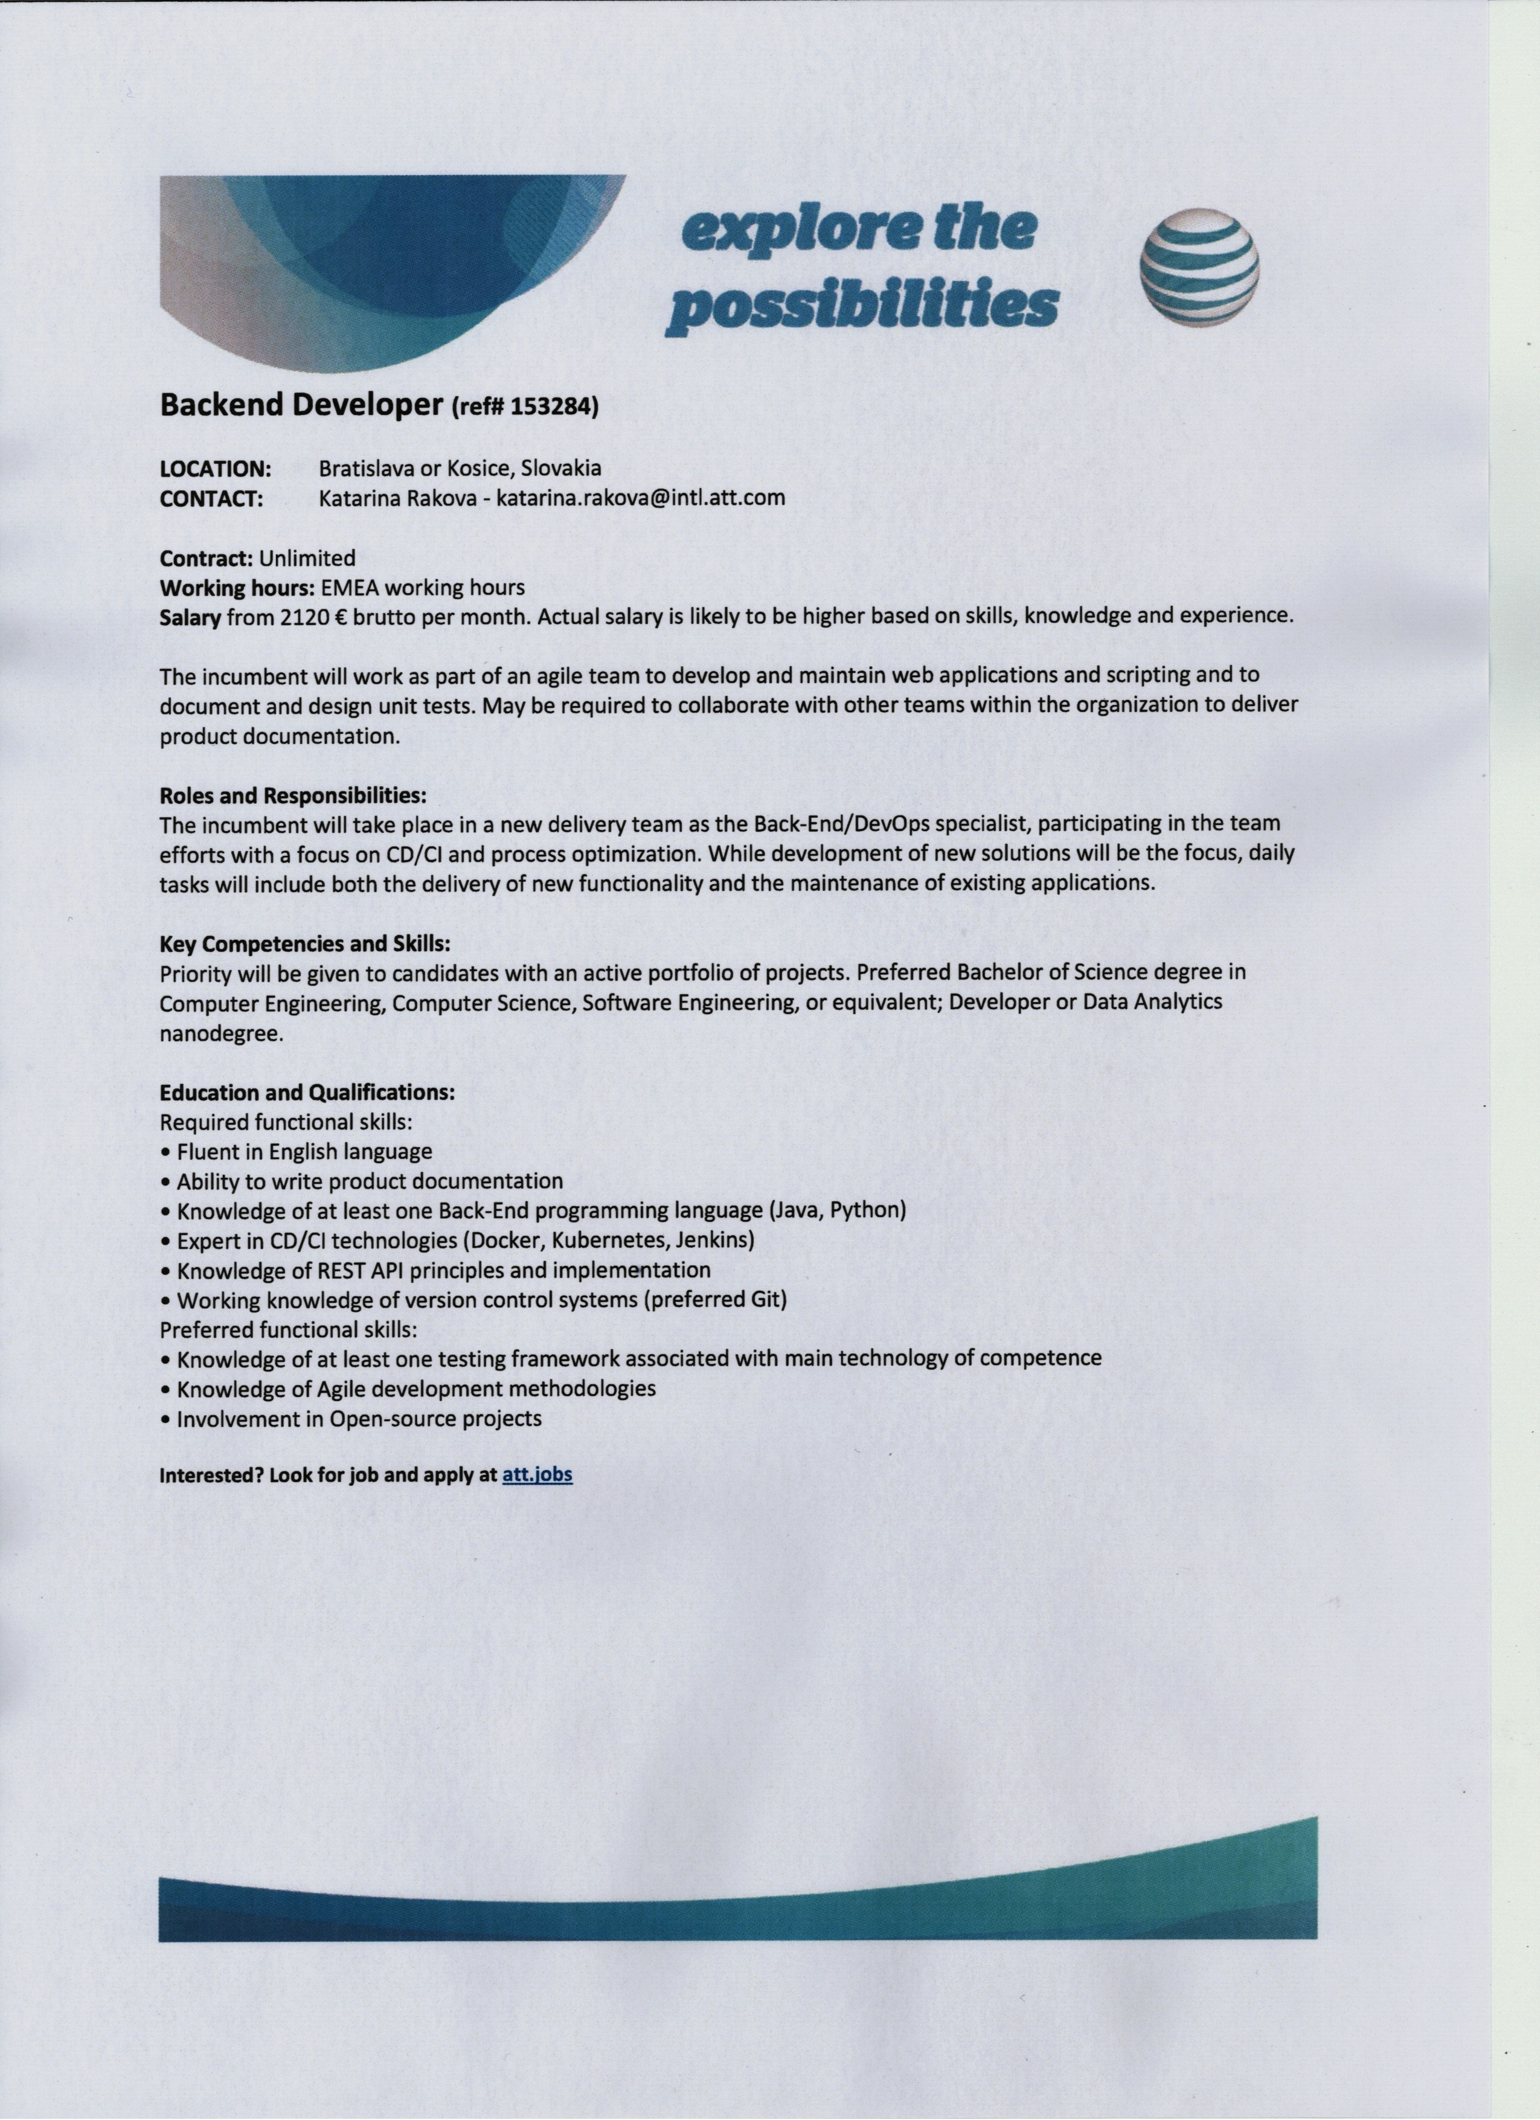
Job offers

Slide 32


Thank you for your attention
Questions?
Mário Lelovský
E: lelovsky@itas.sk, W: www.itas.sk
IT Asociácia Slovenska

