Slide 1
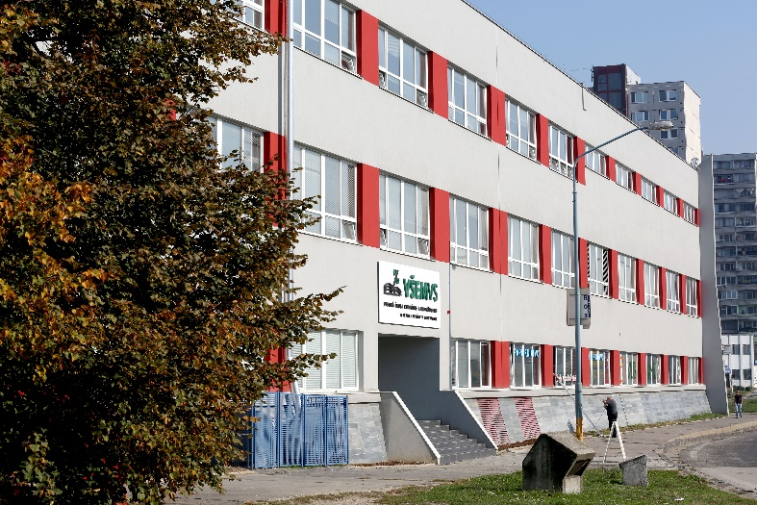
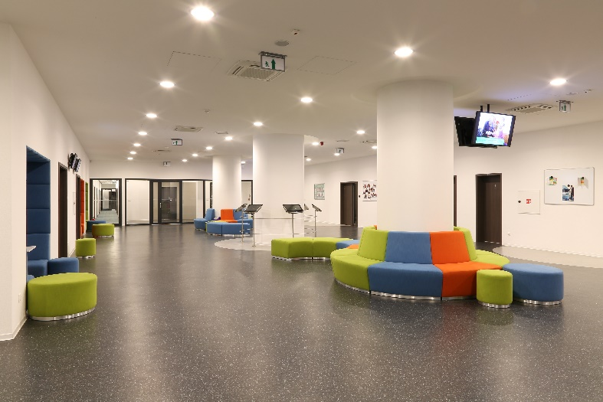

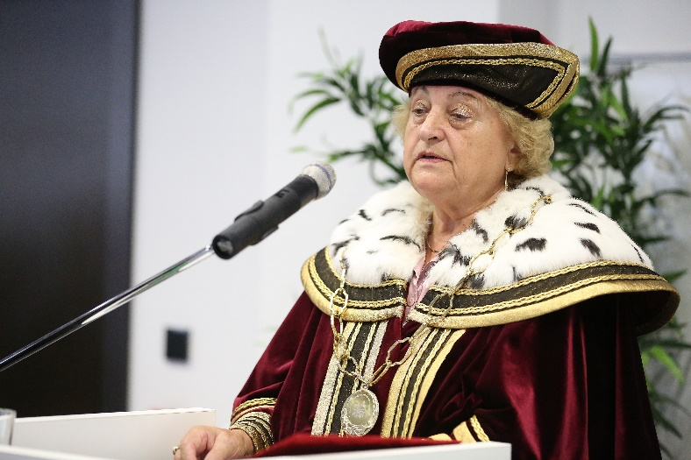
Double Degree Master Study Program for Ukrainan students with employment contract guarantee in Slovakia

Slide 2

Our Mission is your Success.

Slide 3
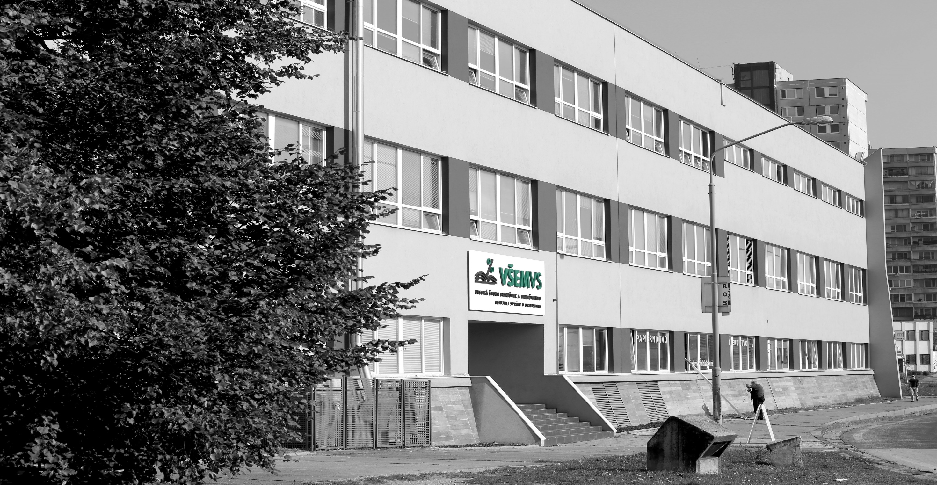

Welcome to our story...
Our Mission is your Success.
www.vsemvs.sk/en

Slide 4
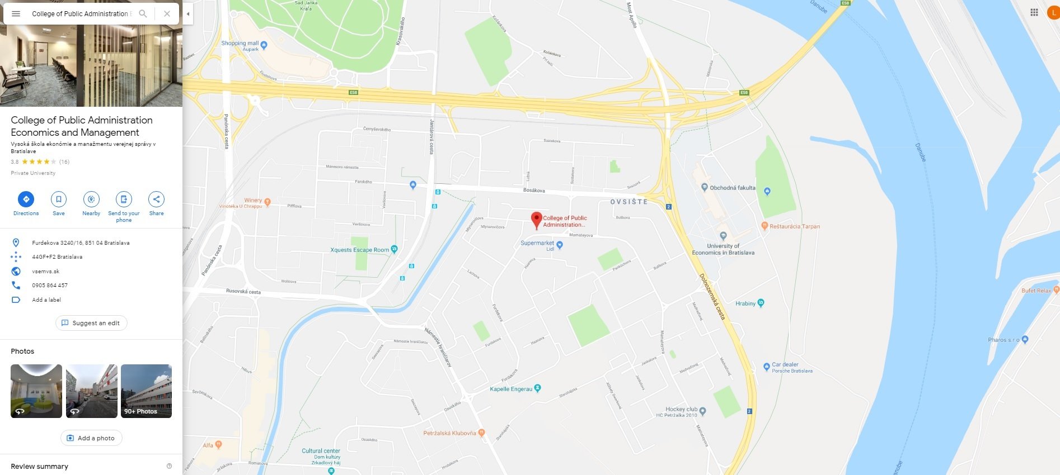
Welcome to our story...
Our Mission is your Success.
www.vsemvs.sk/en

Slide 5
Welcome to our story...
Our Mission is your Success.
www.vsemvs.sk/en

Slide 6
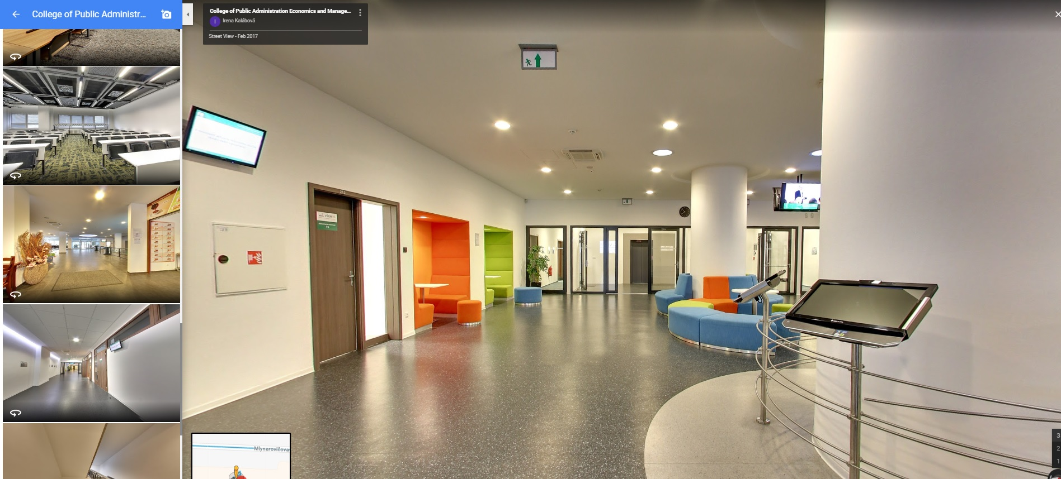
Welcome to our story...
Our Mission is your Success.
www.vsemvs.sk/en

Slide 7
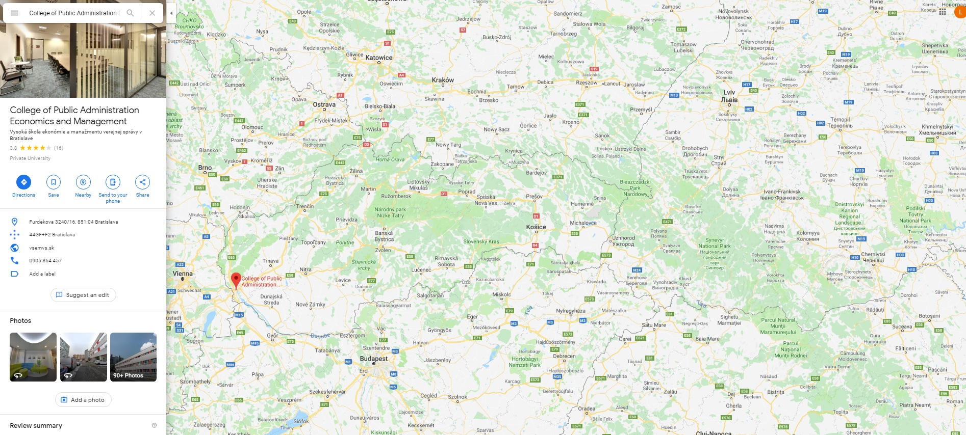
Welcome to our story...
Our Mission is your Success.
www.vsemvs.sk/en

Slide 8

Business school in the heart of Europe
Our Mission is your Success.
www.vsemvs.sk/en

Slide 9
The 1st private HEI* in Slovakia
Public
Administration
Titles:
Bachelor (Bc.)
Master (Mgr.)
Doctor of Philosophy (PhDr.)
Options:
Full-time, Part-time
Management of SME*
in Regions
Titles:
Bachelor (Bc.)
Master (Mgr.)
Doctor of Philosophy (PhDr.)
Options:
Full-time, Part-time
Economics and Management
of Public Services
Titles:
Bachelor (Bc.)
Master (Mgr.)
Doctor of Philosophy (PhDr.)
Options:
Full-time, Part-time
VŠEMVS/SEMPA has in-house knowledge of creating and developing (fully) customized degree and non degree study programs
Our Mission is your Success.
www.vsemvs.sk/en

Slide 10


More than just a business school
Academic excelence
International faculty
Customized programs
Team Competition
Group Achievement
Personal Sacrifice
Regional Development
Start Up Incubator
Carrier Assistance
Cultural Awereness
International Experience
Personal Connections
Our Mission is your Success.
www.vsemvs.sk/en

Slide 11
Let´s start Cooperation!
Furdekova 16, Bratislava,
851 04, Slovakia
www.facebook.com/VSEMvs/
www.twitter.com/VSEMVS_SK/
www.linkedin.com/edu/
info@vsemvs.sk
Rector´s Office
+421 905 864 457
Our Mission is your Success.
www.vsemvs.sk/en

Slide 12
„There is a demand for 13k IT work positions in Slovakia that our UNIs are not able to deliver“
ITAS (2019):
Our Mission is your Success.
www.vsemvs.sk/en

Slide 13
Double Degree Master Study Program for Ukrainan students with 2Y Working contract guarantee in Slovakia
VŠEMvs / ITAS (2017)
Our Mission is your Success.
www.vsemvs.sk/en

Slide 14
Double Degree Master Study Program by ITAS/VŠEMvs
What does it mean?
What do we offer? (to students)
What do we expect? (from students)
Who are our partners?
How does it work?
What do students get?
Our Mission is your Success.
www.vsemvs.sk/en

Slide 15
1. What does it mean?
Double Degree Master Study Program by ITAS/VŠEMvs
Our Mission is your Success.
www.vsemvs.sk/en

Slide 16
Double Degree Master Study Program for Ukrainan students with 2Y Working contract guarantee in Slovakia
1. What does it mean?
All Graduates obtain 2 diplomas:
Master Diploma of Ukrainan University
Master Diploma od Slovak University (EU Diploma)
Our Mission is your Success.
www.vsemvs.sk/en

Slide 17
Double Degree Master Study Program for Ukrainan students with 2Y Working contract guarantee in Slovakia
1. What does it mean?
Study Program is open to all Graduates of Bachelor (Bc.) study program with similar topic (i.e. IT), who can apply to this Master program according Ukrainan rules
Our Mission is your Success.
www.vsemvs.sk/en

Slide 18
Double Degree Master Study Program for Ukrainan students with 2Y Working contract guarantee in Slovakia
1. What does it mean?
After successful finishing of study all graduates will sign regular working contract for two years with the company where the student will do his practice during second years of study.
Our Mission is your Success.
www.vsemvs.sk/en

Slide 19
1. What does it mean?
Legal Framework od Double Degree Programs:
Contract VŠEMvs / UAuni – Double Degree Master Study Program
  Obligatory for Program Registration at Ministry of Education in Slovakia
Contract VŠEMvs / ITAS – IT Companies Selection
  IT Comapnies/IT Practice/IT Positions Demand
Contract VŠEMvs / ITAS / Student
  Provision of Study, Tuition fee, Accomodation, Scholarship
Our Mission is your Success.
www.vsemvs.sk/en

Slide 20
2. What do we offer?
Double Degree Master Study Program by ITAS/VŠEMvs
(to students)
Our Mission is your Success.
www.vsemvs.sk/en

Slide 21
2. What do we offer? (to students)
Fully covered:
Cost of education in Slovakia
Basic monthly scholarship (200€/month)
Cost of dormitory (ca. 120€/month, standard level)
Mandatory health and other insurance (ca. 600€/year)
Additional benefits:
Student working contract (not mandatory, for clever student only!)
Reimbursment of travel cost to UA and back (twice during study)
Reimbursement of cost od education in UA if any (up to 300€)
Our Mission is your Success.
www.vsemvs.sk/en

Slide 22
3. What do we expect?
Double Degree Master Study Program by ITAS/VŠEMvs
(from students)
Our Mission is your Success.
www.vsemvs.sk/en

Slide 23
3. What do we expect? (from students)
Successful enrollment to UA university
Good study results
Good programming skills
Appropriate English language skills
Readiness to go through Programming assesment test (twice)
Readiness to go through Slovak language course (A1, A2, B1, B2)
Readiness to go through English language course (if necessary)
Readiness to finish study in Slovak language
Slovak language skills (at least) on level A1 before entering Slovakia
Our Mission is your Success.
www.vsemvs.sk/en

Slide 24
4. Who are our partners?
Double Degree Master Study Program by ITAS/VŠEMvs
Our Mission is your Success.
www.vsemvs.sk/en

Slide 25

Simon Kuznets Kharkiv National University of Economics
Харківський національний економічний університет імені Семена Кузнеця
„Бізнес-аналітика та інформаційні системи в підприємництві.
(Registration code in Slovakia 183323)

Slide 26

Uzhhorod National University
Ужгородський національний університет
„Інженерія програмного забезпечення та бізнес-аналіз“
(Registration code in Slovakia 183669)

Slide 27

Yurii Fedkovych Chernivtsi National University
Чернівецький національний університет імені Юрія Федьковича
„Інженерія програмного забезпечення в підприємництві“
(Registration code in Slovakia 183672)

Slide 28

Kyiv National University of Trade and Economics
Київський національний торговельно-економічний університет
„Міжнародна бізнес-аналітика“
(Registration code in Slovakia 183667)

Slide 29

Odessa National Polytechnic University
Одеський національний політехнічний університет
„Бізнес-аналітика та інформаційні технології в підприємництві“
(Registration code in Slovakia 183670)

Slide 30

Lviv Polytechnic National University
Національний університет "Львівська політехніка„
„Штучний інтелект та інформаційні системи в підприємництві“
(Registration code in Slovakia 183668)

Slide 31

Lviv Polytechnic National University
Національний технічний університет "Харківський політехнічний інститут"

Slide 32
Who are our partners?

Slide 33
4. Who are our partners?
Already registered DD MSP:
Simon Kuznets Kharkiv National University of Economics
Uzhhorod National University
Yurii Fedkovych Chernivtsi National University
Kyiv National University of Trade and Economics
Odessa National Polytechnic University
Lviv Polytechnic National University
Kharkiv Polytechnic Institute
At work (Prepared for registration):
University of the State Fiscal Service of Ukraine
Our Mission is your Success.
www.vsemvs.sk/en

Slide 34
5. How does it work?
Double Degree Master Study Program by ITAS/VŠEMvs
Our Mission is your Success.
www.vsemvs.sk/en

Slide 35
5. How does it work?
No. | Title | Campus
1 | Admission | Ukraine
2 | 1st year of study | Ukraine
3 | Summer practice 1 | Slovakia
4 | 2nd year of study | Slovakia
5 | Summer Practice 2 | Slovakia
6 | Finishing study | Slovakia
7 | Working contract | Slovakia
Our Mission is your Success.
www.vsemvs.sk/en

Slide 36
5. How does it work?
Title | From | To | Duration | Campus
Admission | July 2019 | August 2019 | 2 months | UA
1st semester | October 2019 | January 2020 | 4 months | UA
2nd semester | February 2020 | June 2020 | 5 months | UA
Summer Practice 1 | July 2020 | August 2020 | 2 months | SK
3rd semester | October 2020 | January 2021 | 4 months | SK
4th semester | February 2021 | May 2021 | 4 months | SK
Summer Practice 2 | June 2021 | July 2021 | 2 months | SK
Finishing the Study | August 2021 | August 2021 | 1 months | SK
Working Contract | September 2021 | August 2023+ | 2+ years | SK
7 | 8 | 9 | 10 | 11 | 12 | 1 | 2 | 3 | 4 | 5 | 6 | 7 | 8 | 9 | 10 | 11 | 12 | 1 | 2 | 3 | 4 | 5 | 6 | 7 | 8 | 9
Our Mission is your Success.
www.vsemvs.sk/en

Slide 37
5. How does it work?
Title | From | To | Duration | Campus
Admission | July 2019 | August 2019 | 2 months | UA
1st semester | October 2019 | January 2020 | 4 months | UA
2nd semester | February 2020 | June 2020 | 5 months | UA
Summer Practice 1 | July 2020 | August 2020 | 2 months | SK
3rd semester | October 2020 | January 2021 | 4 months | SK
4th semester | February 2021 | May 2021 | 4 months | SK
Summer Practice 2 | June 2021 | July 2021 | 2 months | SK
Finishing the Study | August 2021 | August 2021 | 1 months | SK
Working Contract | September 2021 | August 2023+ | 2+ years | SK
7 | 8 | 9 | 10 | 11 | 12 | 1 | 2 | 3 | 4 | 5 | 6 | 7 | 8 | 9 | 10 | 11 | 12 | 1 | 2 | 3 | 4 | 5 | 6 | 7 | 8 | 9
Our Mission is your Success.
www.vsemvs.sk/en

Slide 38
5. How does it work?
Title | From | To | Duration | Campus
Admission | July 2019 | August 2019 | 2 months | UA
1st semester | October 2019 | January 2020 | 4 months | UA
2nd semester | February 2020 | June 2020 | 5 months | UA
Summer Practice 1 | July 2020 | August 2020 | 2 months | SK
3rd semester | October 2020 | January 2021 | 4 months | SK
4th semester | February 2021 | May 2021 | 4 months | SK
Summer Practice 2 | June 2021 | July 2021 | 2 months | SK
Finishing the Study | August 2021 | August 2021 | 1 months | SK
Working Contract | September 2021 | August 2023+ | 2+ years | SK
7 | 8 | 9 | 10 | 11 | 12 | 1 | 2 | 3 | 4 | 5 | 6 | 7 | 8 | 9 | 10 | 11 | 12 | 1 | 2 | 3 | 4 | 5 | 6 | 7 | 8 | 9
Our Mission is your Success.
www.vsemvs.sk/en

Slide 39
5. How does it work?
Title | From | To | Duration | Campus
Admission | July 2019 | August 2019 | 2 months | UA
1st semester | October 2019 | January 2020 | 4 months | UA
2nd semester | February 2020 | June 2020 | 5 months | UA
Summer Practice 1 | July 2020 | August 2020 | 2 months | SK
3rd semester | October 2020 | January 2021 | 4 months | SK
4th semester | February 2021 | May 2021 | 4 months | SK
Summer Practice 2 | June 2021 | July 2021 | 2 months | SK
Finishing the Study | August 2021 | August 2021 | 1 months | SK
Working Contract | September 2021 | August 2023+ | 2+ years | SK
7 | 8 | 9 | 10 | 11 | 12 | 1 | 2 | 3 | 4 | 5 | 6 | 7 | 8 | 9 | 10 | 11 | 12 | 1 | 2 | 3 | 4 | 5 | 6 | 7 | 8 | 9
Our Mission is your Success.
www.vsemvs.sk/en

Slide 40
5. How does it work?
Title | From | To | Duration | Campus
Admission | July 2019 | August 2019 | 2 months | UA
1st semester | October 2019 | January 2020 | 4 months | UA
2nd semester | February 2020 | June 2020 | 5 months | UA
Summer Practice 1 | July 2020 | August 2020 | 2 months | SK
3rd semester | October 2020 | January 2021 | 4 months | SK
4th semester | February 2021 | May 2021 | 4 months | SK
Summer Practice 2 | June 2021 | July 2021 | 2 months | SK
Finishing the Study | August 2021 | August 2021 | 1 months | SK
Working Contract | September 2021 | August 2023+ | 2+ years | SK
7 | 8 | 9 | 10 | 11 | 12 | 1 | 2 | 3 | 4 | 5 | 6 | 7 | 8 | 9 | 10 | 11 | 12 | 1 | 2 | 3 | 4 | 5 | 6 | 7 | 8 | 9
Our Mission is your Success.
www.vsemvs.sk/en

Slide 41
5. How does it work?
Title | From | To | Duration | Campus
Admission | July 2019 | August 2019 | 2 months | UA
1st semester | October 2019 | January 2020 | 4 months | UA
2nd semester | February 2020 | June 2020 | 5 months | UA
Summer Practice 1 | July 2020 | August 2020 | 2 months | SK
3rd semester | October 2020 | January 2021 | 4 months | SK
4th semester | February 2021 | May 2021 | 4 months | SK
Summer Practice 2 | June 2021 | July 2021 | 2 months | SK
Finishing the Study | August 2021 | August 2021 | 1 months | SK
Working Contract | September 2021 | August 2023+ | 2+ years | SK
7 | 8 | 9 | 10 | 11 | 12 | 1 | 2 | 3 | 4 | 5 | 6 | 7 | 8 | 9 | 10 | 11 | 12 | 1 | 2 | 3 | 4 | 5 | 6 | 7 | 8 | 9
Our Mission is your Success.
www.vsemvs.sk/en

Slide 42
5. How does it work?
Title | From | To | Duration | Campus
Admission | July 2019 | August 2019 | 2 months | UA
1st semester | October 2019 | January 2020 | 4 months | UA
2nd semester | February 2020 | June 2020 | 5 months | UA
Summer Practice 1 | July 2020 | August 2020 | 2 months | SK
3rd semester | October 2020 | January 2021 | 4 months | SK
4th semester | February 2021 | May 2021 | 4 months | SK
Summer Practice 2 | June 2021 | July 2021 | 2 months | SK
Finishing the Study | August 2021 | August 2021 | 1 months | SK
Working Contract | September 2021 | August 2023+ | 2+ years | SK
7 | 8 | 9 | 10 | 11 | 12 | 1 | 2 | 3 | 4 | 5 | 6 | 7 | 8 | 9 | 10 | 11 | 12 | 1 | 2 | 3 | 4 | 5 | 6 | 7 | 8 | 9
Our Mission is your Success.
www.vsemvs.sk/en

Slide 43
5. How does it work?
Title | From | To | Duration | Campus
Admission | July 2019 | August 2019 | 2 months | UA
1st semester | October 2019 | January 2020 | 4 months | UA
2nd semester | February 2020 | June 2020 | 5 months | UA
Summer Practice 1 | July 2020 | August 2020 | 2 months | SK
3rd semester | October 2020 | January 2021 | 4 months | SK
4th semester | February 2021 | May 2021 | 4 months | SK
Summer Practice 2 | June 2021 | July 2021 | 2 months | SK
Finishing the Study | August 2021 | August 2021 | 1 months | SK
Working Contract | September 2021 | August 2023+ | 2+ years | SK
7 | 8 | 9 | 10 | 11 | 12 | 1 | 2 | 3 | 4 | 5 | 6 | 7 | 8 | 9 | 10 | 11 | 12 | 1 | 2 | 3 | 4 | 5 | 6 | 7 | 8 | 9
Our Mission is your Success.
www.vsemvs.sk/en

Slide 44
5. How does it work?
Title | From | To | Duration | Campus
Admission | July 2019 | August 2019 | 2 months | UA
1st semester | October 2019 | January 2020 | 4 months | UA
2nd semester | February 2020 | June 2020 | 5 months | UA
Summer Practice 1 | July 2020 | August 2020 | 2 months | SK
3rd semester | October 2020 | January 2021 | 4 months | SK
4th semester | February 2021 | May 2021 | 4 months | SK
Summer Practice 2 | June 2021 | July 2021 | 2 months | SK
Finishing the Study | August 2021 | August 2021 | 1 months | SK
Working Contract | September 2021 | August 2023+ | 2+ years | SK
7 | 8 | 9 | 10 | 11 | 12 | 1 | 2 | 3 | 4 | 5 | 6 | 7 | 8 | 9 | 10 | 11 | 12 | 1 | 2 | 3 | 4 | 5 | 6 | 7 | 8 | 9
Our Mission is your Success.
www.vsemvs.sk/en

Slide 45
5. How does it work?
Title | From | To | Duration | Campus
Admission | July 2019 | August 2019 | 2 months | UA
1st semester | October 2019 | January 2020 | 4 months | UA
2nd semester | February 2020 | June 2020 | 5 months | UA
Summer Practice 1 | July 2020 | August 2020 | 2 months | SK
3rd semester | October 2020 | January 2021 | 4 months | SK
4th semester | February 2021 | May 2021 | 4 months | SK
Summer Practice 2 | June 2021 | July 2021 | 2 months | SK
Finishing the Study | August 2021 | August 2021 | 1 months | SK
Working Contract | September 2021 | August 2023+ | 2+ years | SK
7 | 8 | 9 | 10 | 11 | 12 | 1 | 2 | 3 | 4 | 5 | 6 | 7 | 8 | 9 | 10 | 11 | 12 | 1 | 2 | 3 | 4 | 5 | 6 | 7 | 8 | 9
Our Mission is your Success.
www.vsemvs.sk/en

Slide 46
6. What do students get?
Double Degree Master Study Program by ITAS/VŠEMvs
Our Mission is your Success.
www.vsemvs.sk/en

Slide 47
6. What do students get?
EU (Schengen) Visas
Slovak language courses
IT Specialization courses
IT Company selection
IT Practice
Student contract
Working contract
Our Mission is your Success.
www.vsemvs.sk/en

Slide 48
6.1. EU (Schengen) Visa
Student:
Biometric passport
Extract from the police records
VŠEMvs:
Enrollment confirmation document
Financial funding confirmation
Embassy/Consulate:
Applications
Interview
Student Visa + Student residence permit
Our Mission is your Success.
www.vsemvs.sk/en

Slide 49
6.2. Slovak language course
Prepared by VŠEMvs for levels A1, A2, B1, B2
Implemented in Moodle portal (https://moodle.vsemvs.sk )
Based on open eLearning course developed for MoFA
Slovak teacher/coordinator is provided
Schedule:
  A1 – before entering Slovakia
  A2 – Summer Practice 1
  B1 – 3rd semester
  B2 – 4th semester
Certificate at the end of study
Our Mission is your Success.
www.vsemvs.sk/en

Slide 50
6.3. IT Specialization course
Java specialization course prepared by UA teachers
Divided into 2 parts
  Part 1 organized in UA (end of 1st year od study)
  Part 2 organized in SK (Summer Practice 1)
General Assesment test prepared
Assesment test is to do twice
  At the beginning of course (detailed information will be sens by email)
  At the end of course (during Summer Practice 1)
Expected level 80% / Minimum level 60%
Results are taken into account by Company matching
Our Mission is your Success.
www.vsemvs.sk/en

Slide 51
6.4. IT Company selection
Step | Activity | Done by
1 | Self assesments of skills | All Students
2 | Student profiles definition | ITAS
3 | Open position description | All Companies
4 | Open roles definiiton | ITAS
5 | 1st round of matching | ITAS
6 | Summer practice 1 | in selected companies
7 | Feedback | students/companies
8 | 2nd rounf of matching (optional) | ITAS
Our Mission is your Success.
www.vsemvs.sk/en

Slide 52
6.4. IT Company selection
Starting Positions:
„Programmer“
Application developer
Java/C#
iOS
Database developer
Database developer
1. „Entry“ position
2. Student position
3. Working position
Database Analyst
System engineer
SAP
Our Mission is your Success.
www.vsemvs.sk/en

Slide 53
6.5. IT Practice / 6.6. Student contract
Basic practice is covered by monthly scholarship
Student working contract is optional
It depends on student activity/outcome in „his/her“ IT company
Legal framework allows up to 20 hrs per week
Typical hourly rate is 4-6 €
Example: 80 hrs x 5€ = 400€ (brutto, student taxation is due)
Our Mission is your Success.
www.vsemvs.sk/en

Slide 54
6.7. Working contract
All graduates are allowed (within 6 months after finishing study) to sign regular working contract
Slovak legal framework allows fixed term contract up to 2 years
Signing working contract is for all graduates obligatory
Not signing working contract after succesfull finishing of study is a fundamental breach of Contract
Our Mission is your Success.
www.vsemvs.sk/en

Slide 55
Ďakujeme za pozornosť
Thanks for Your Attention!
Our Mission is your Success.
www.vsemvs.sk/en

Slide 56
Otázky?
Questions?
Our Mission is your Success.
www.vsemvs.sk/en

Slide 57
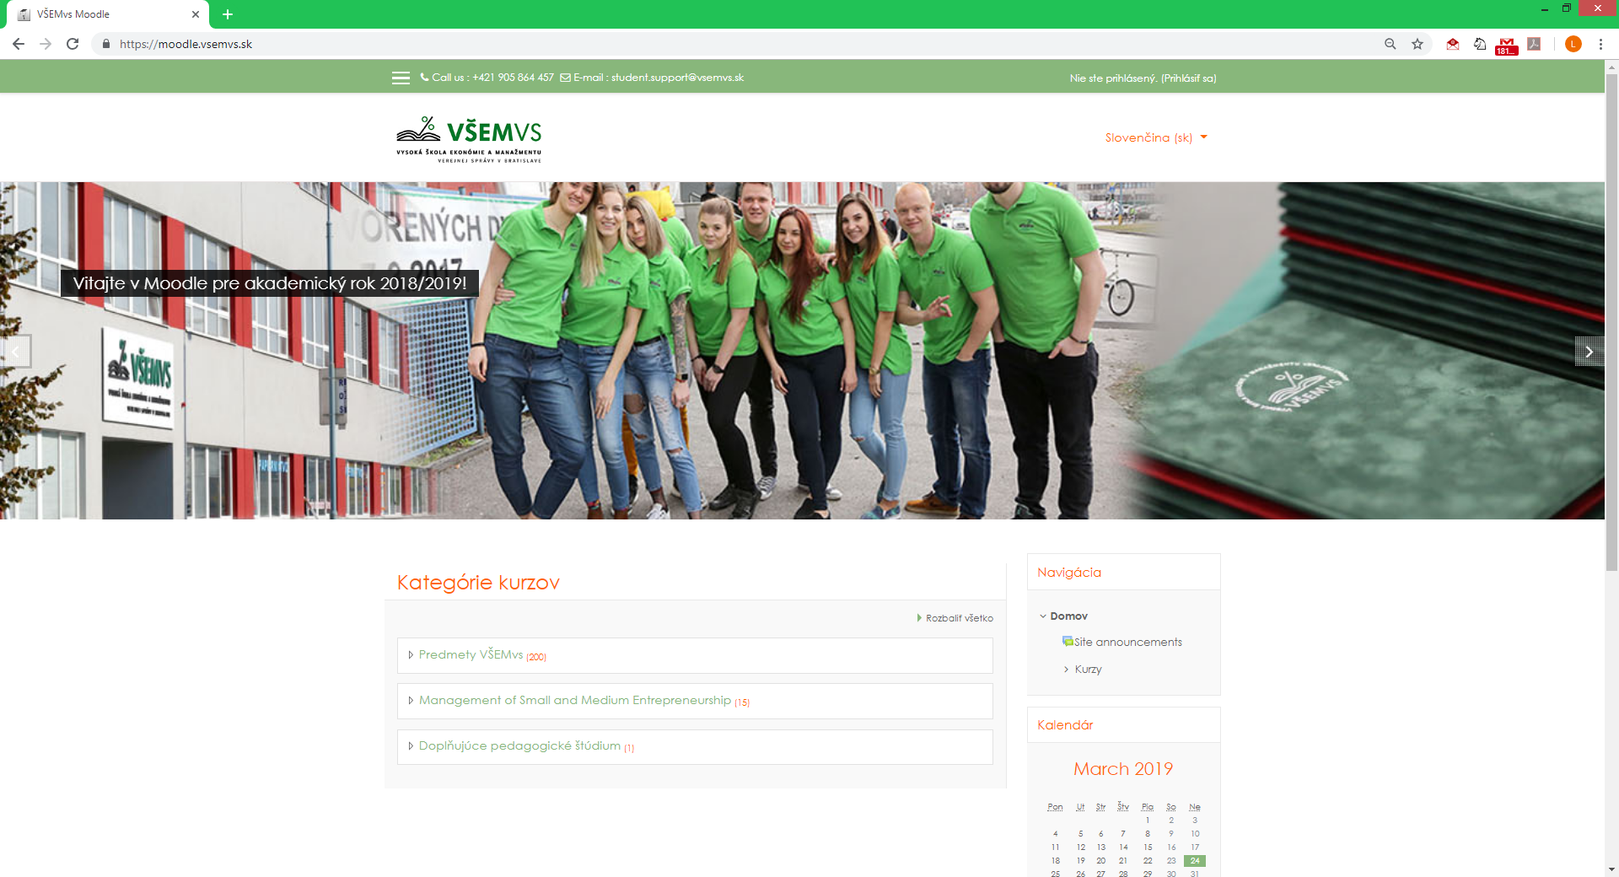
http://moodle.vsemvs.sk

Slide 58
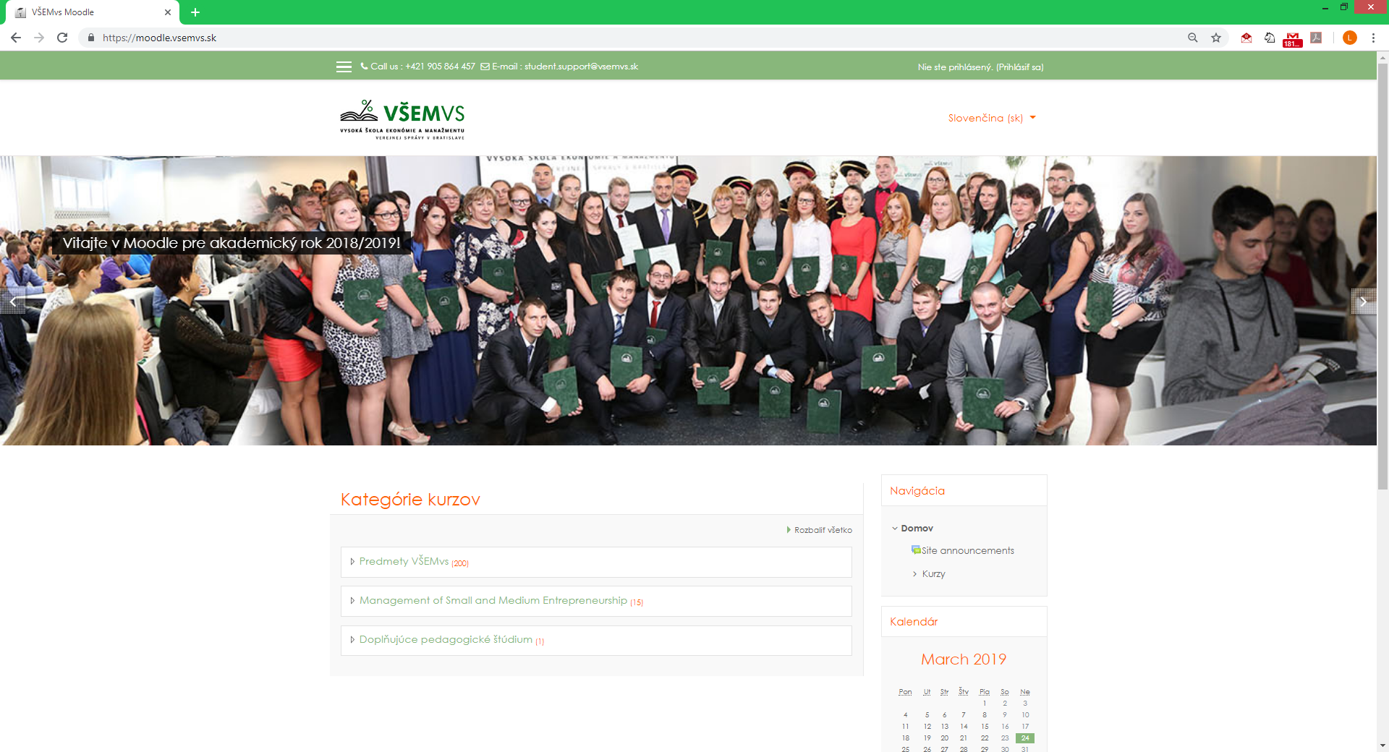
http://moodle.vsemvs.sk

Slide 59
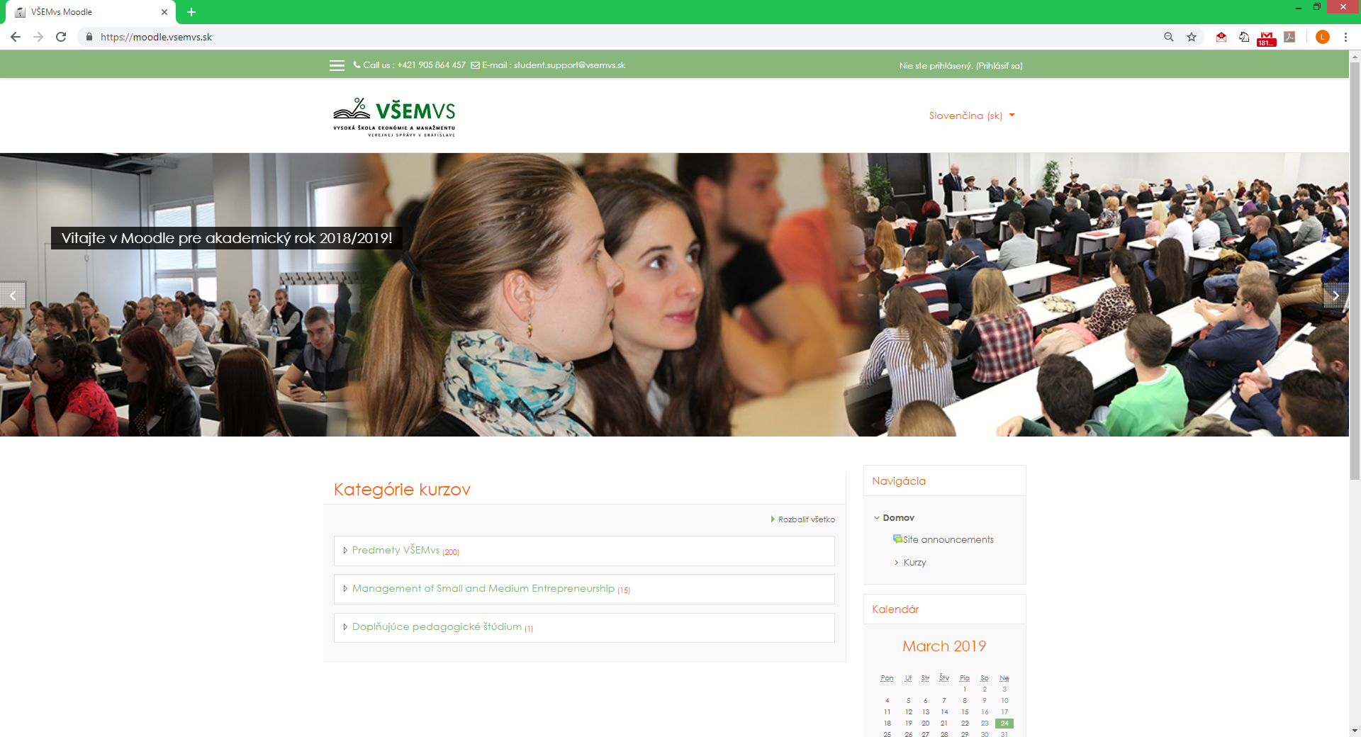
http://moodle.vsemvs.sk

Slide 60
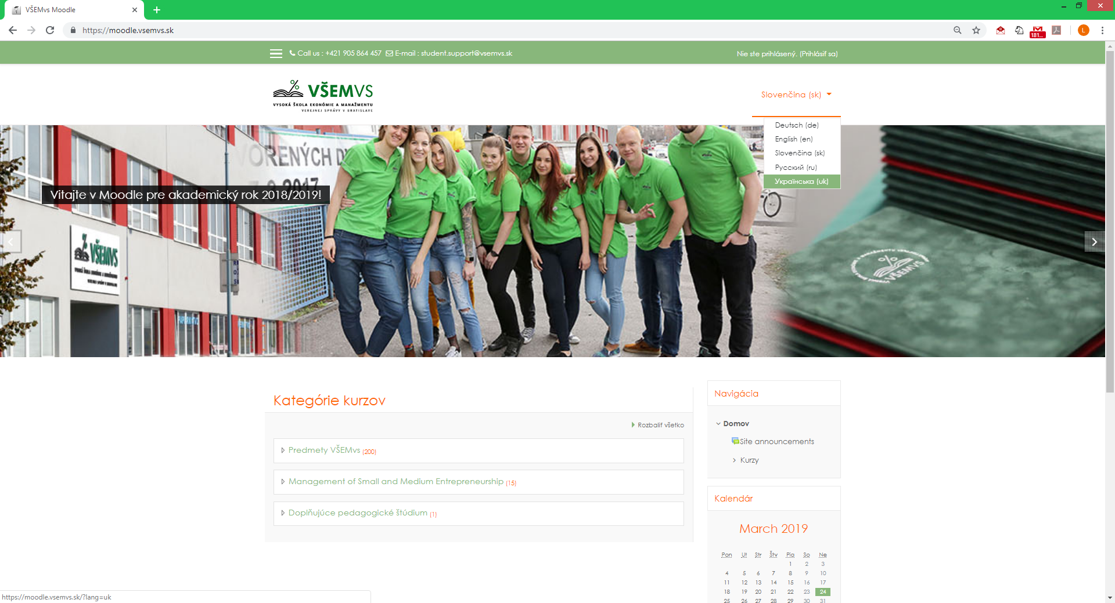
http://moodle.vsemvs.sk

Slide 61

http://moodle.vsemvs.sk

Slide 62
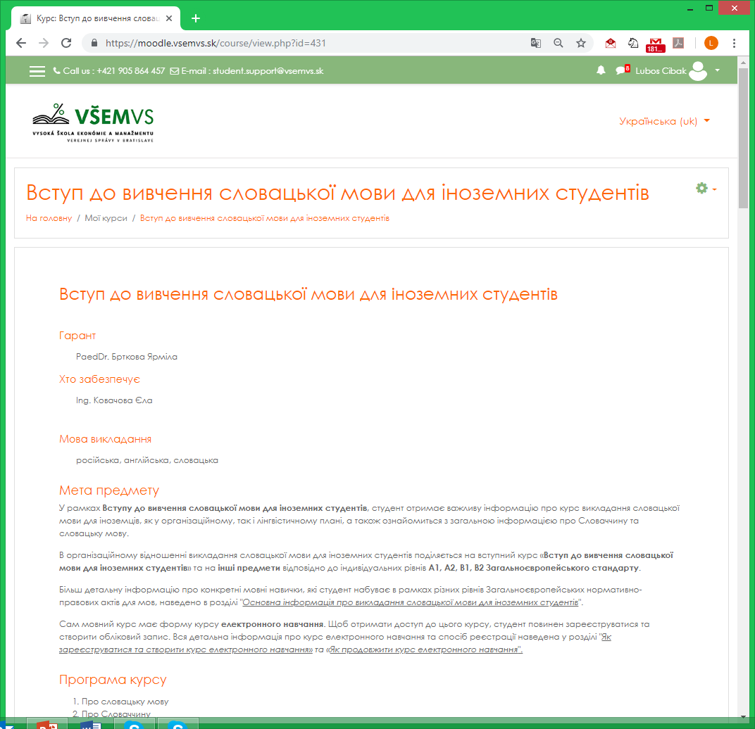
Slovak language courses

Slide 63
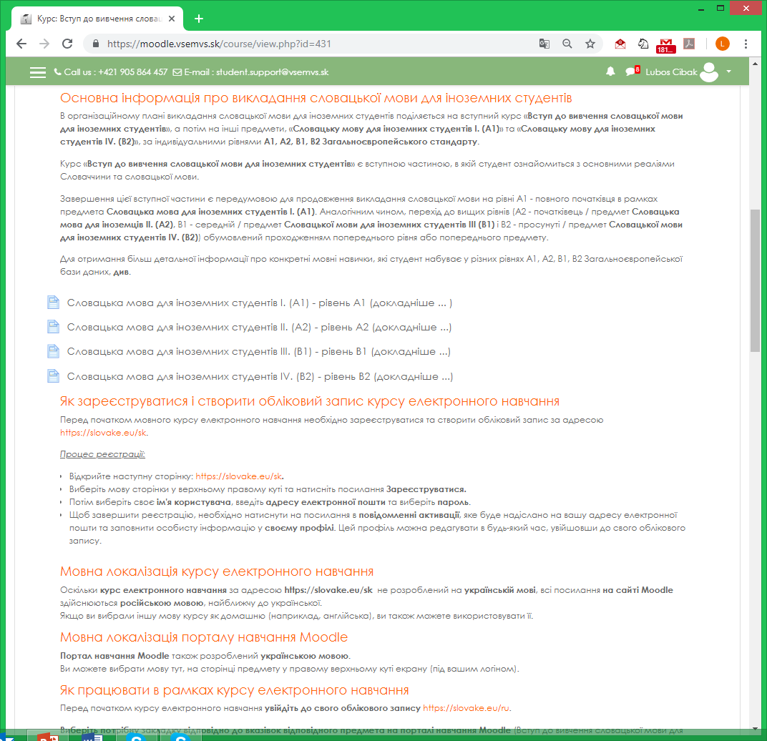
Slovak language courses

Slide 64
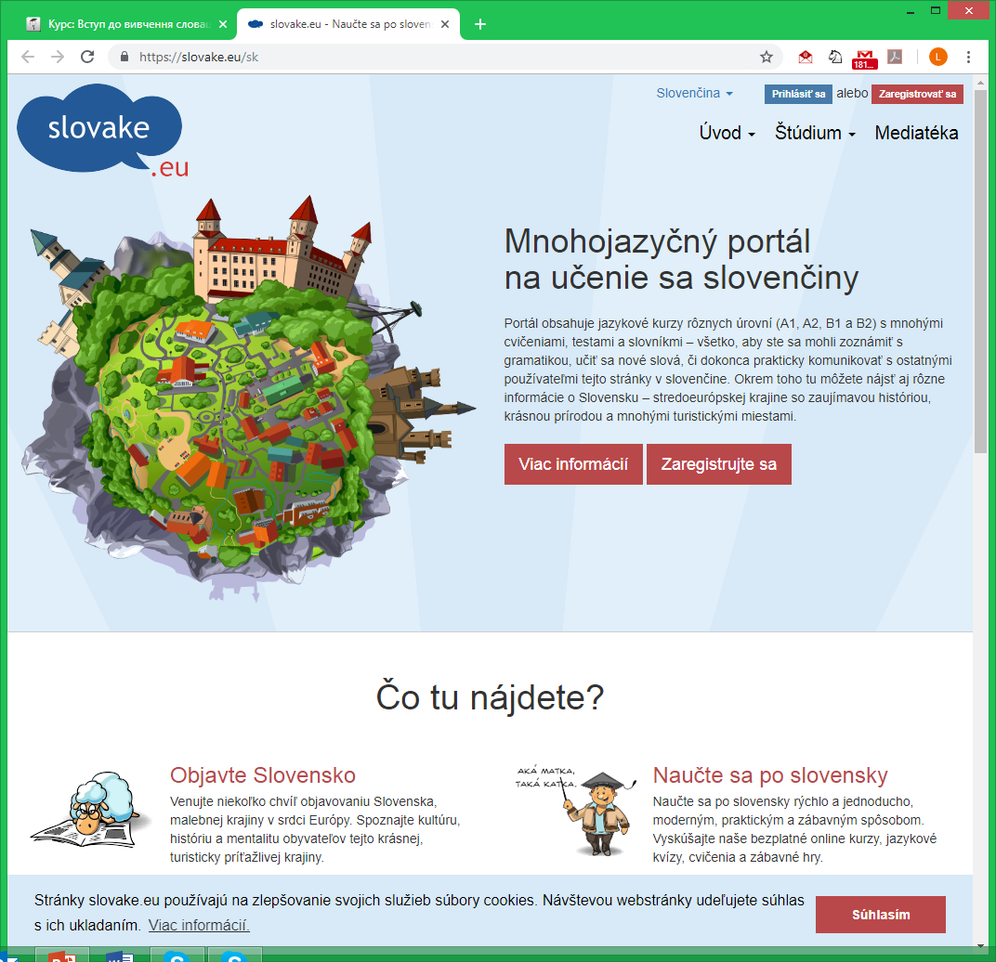
Slovak language courses

Slide 65
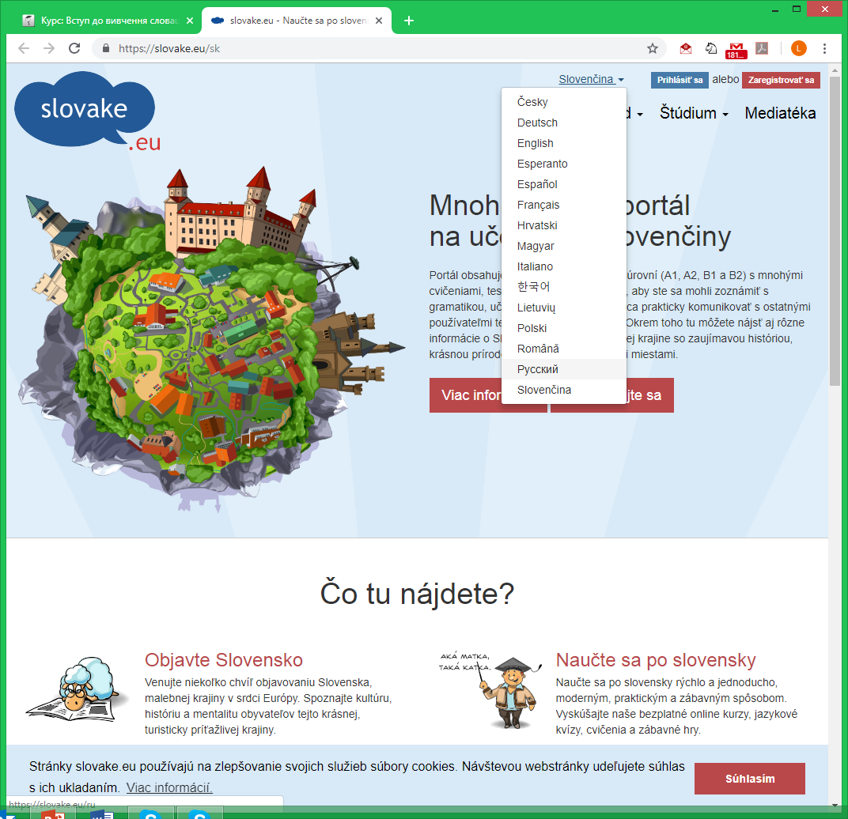
Slovak language courses

Slide 66
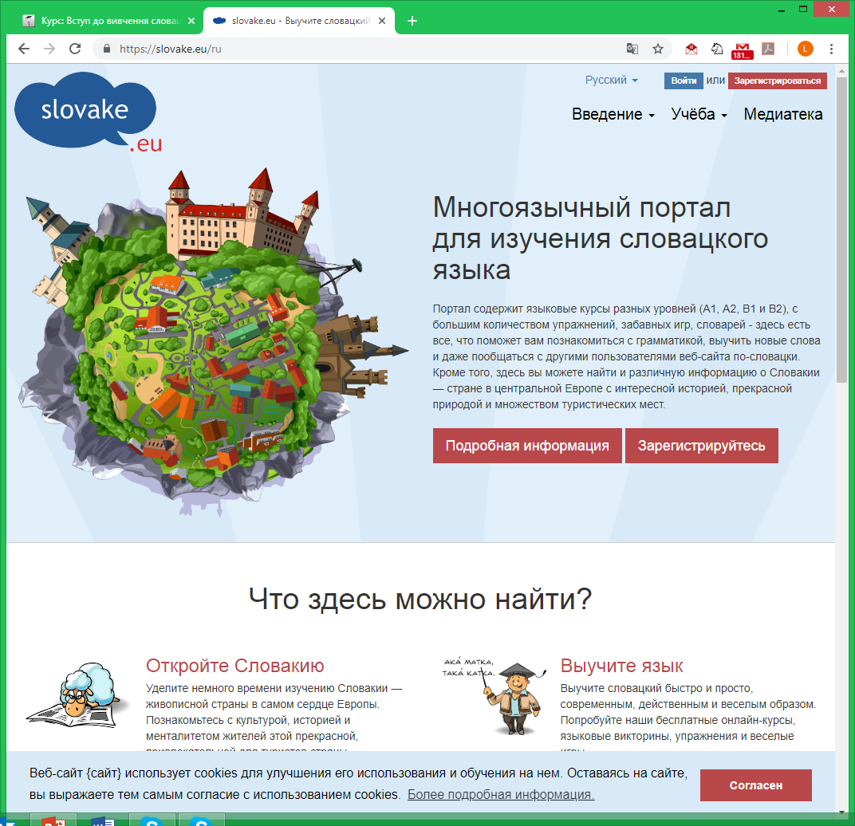
Slovak language courses

Slide 67
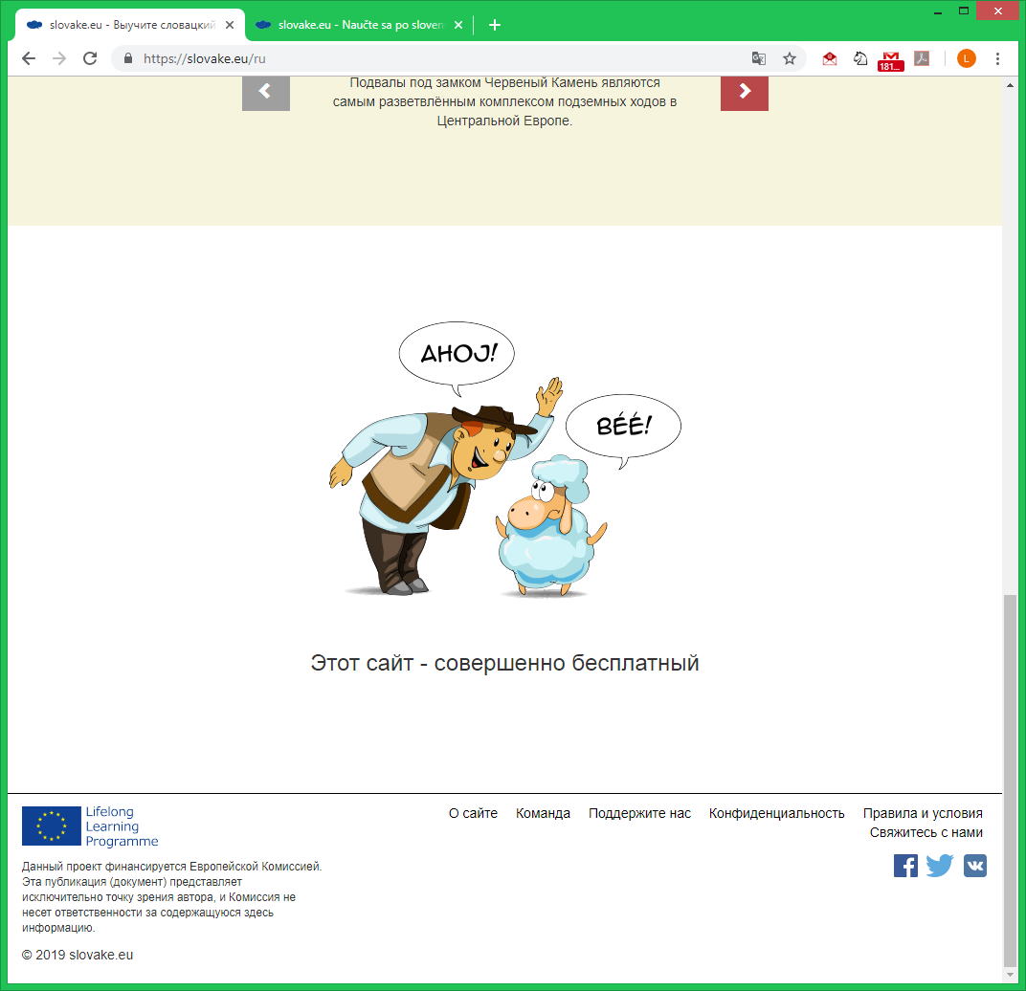
Slovak language courses

Slide 68
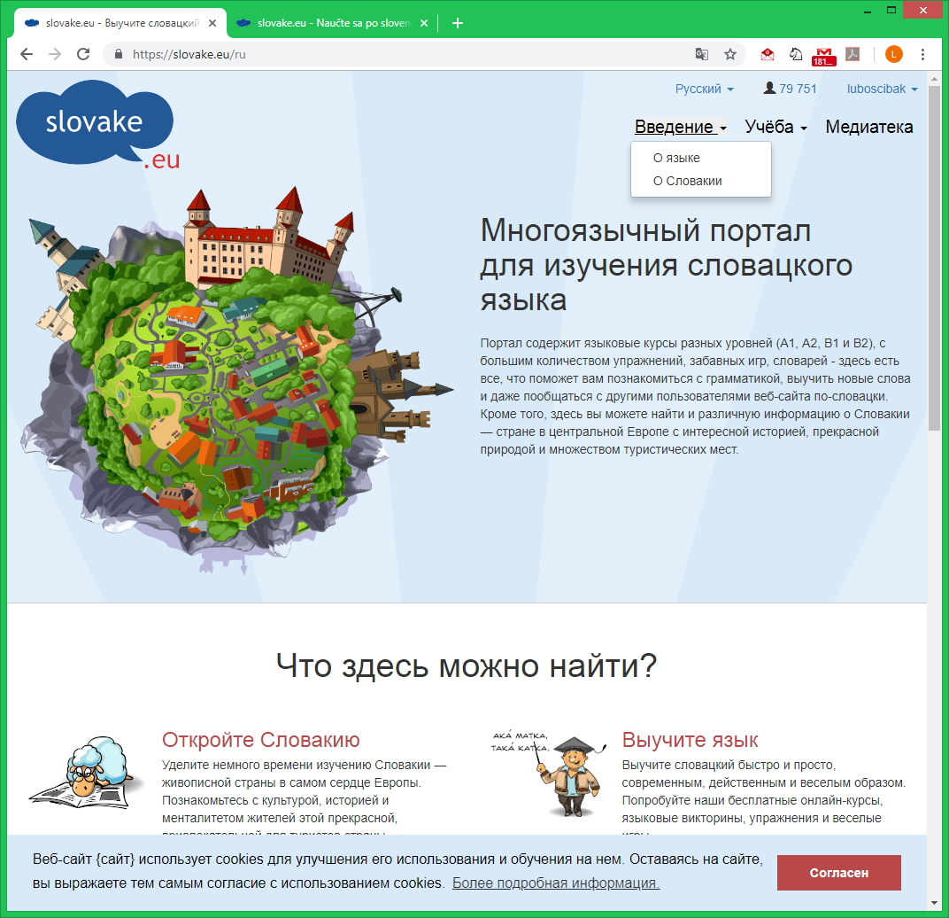
Slovak language courses

Slide 69
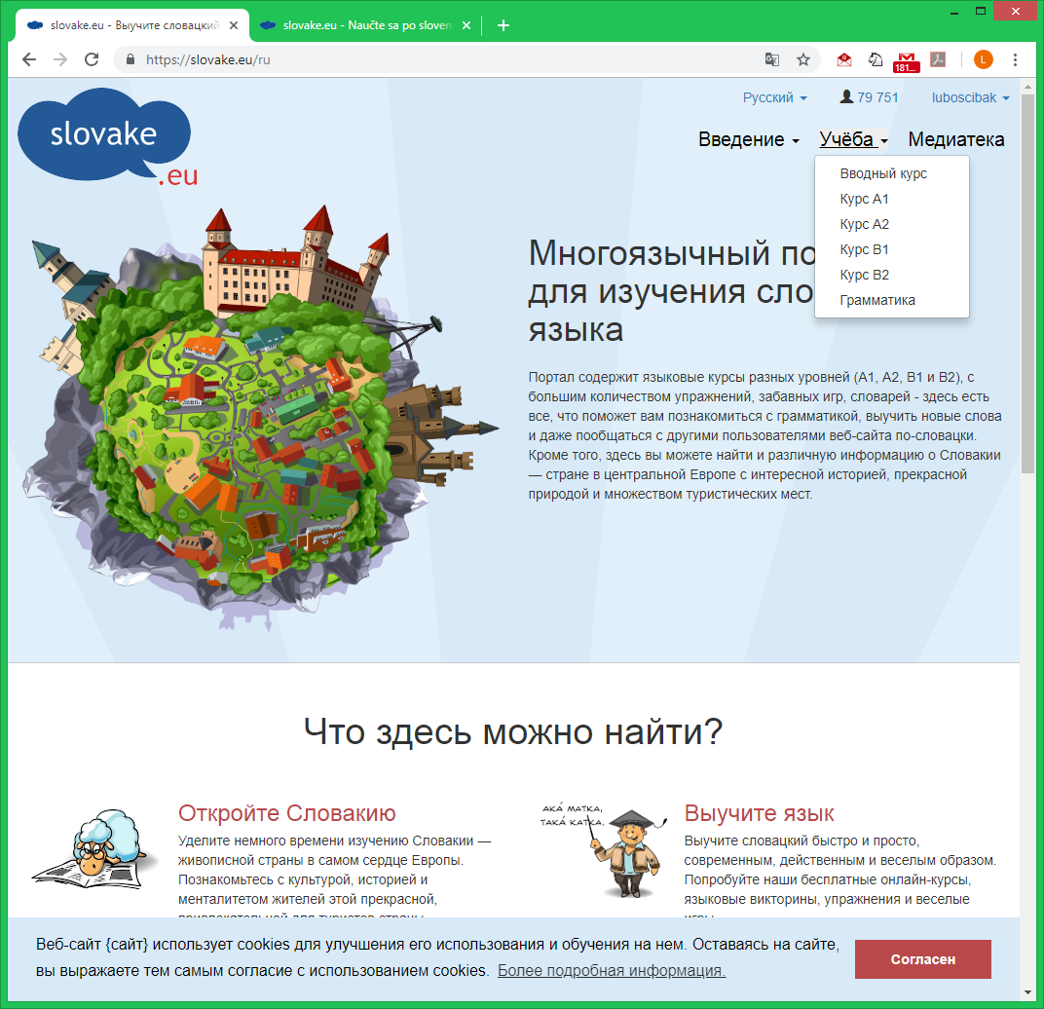
Slovak language courses

Slide 70
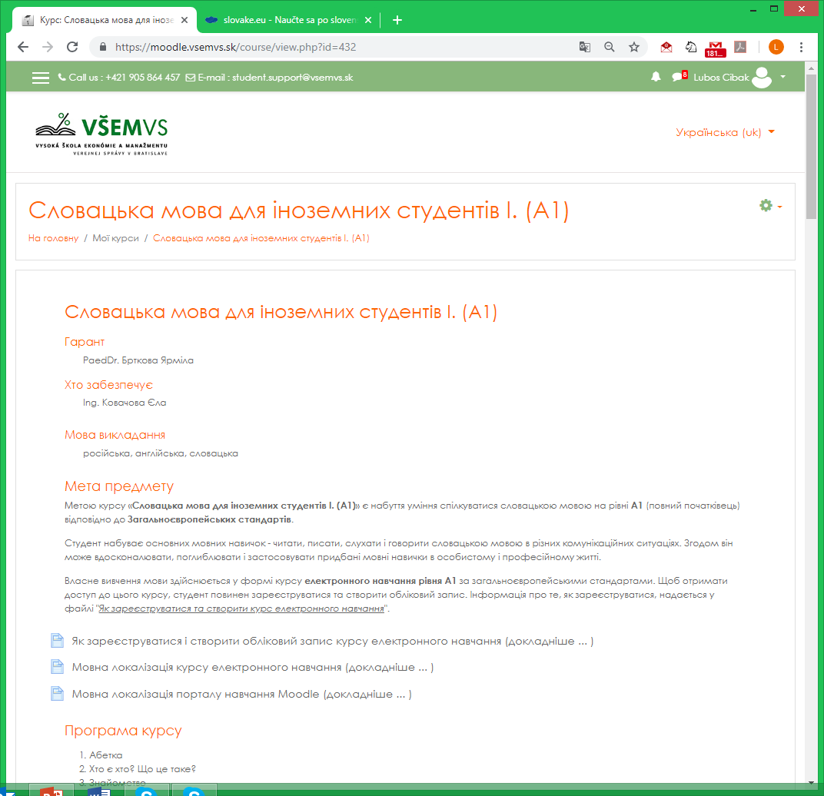
Slovak language courses

Slide 71
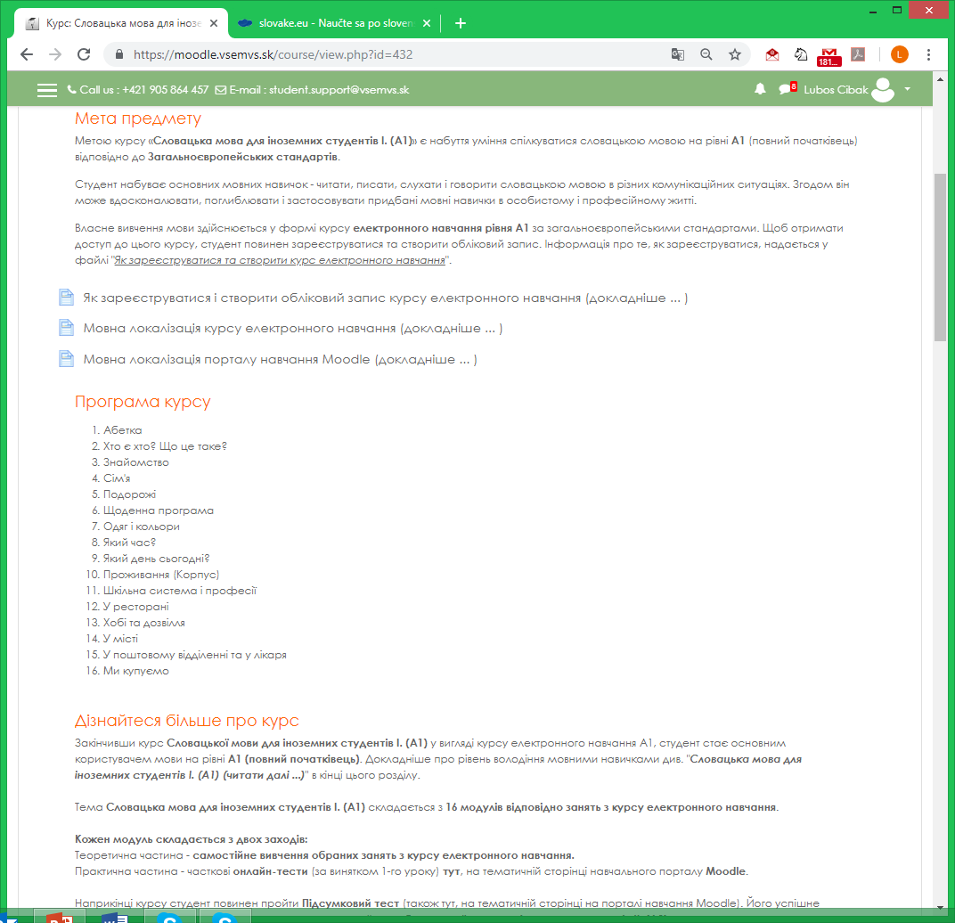
Slovak language courses

Slide 72
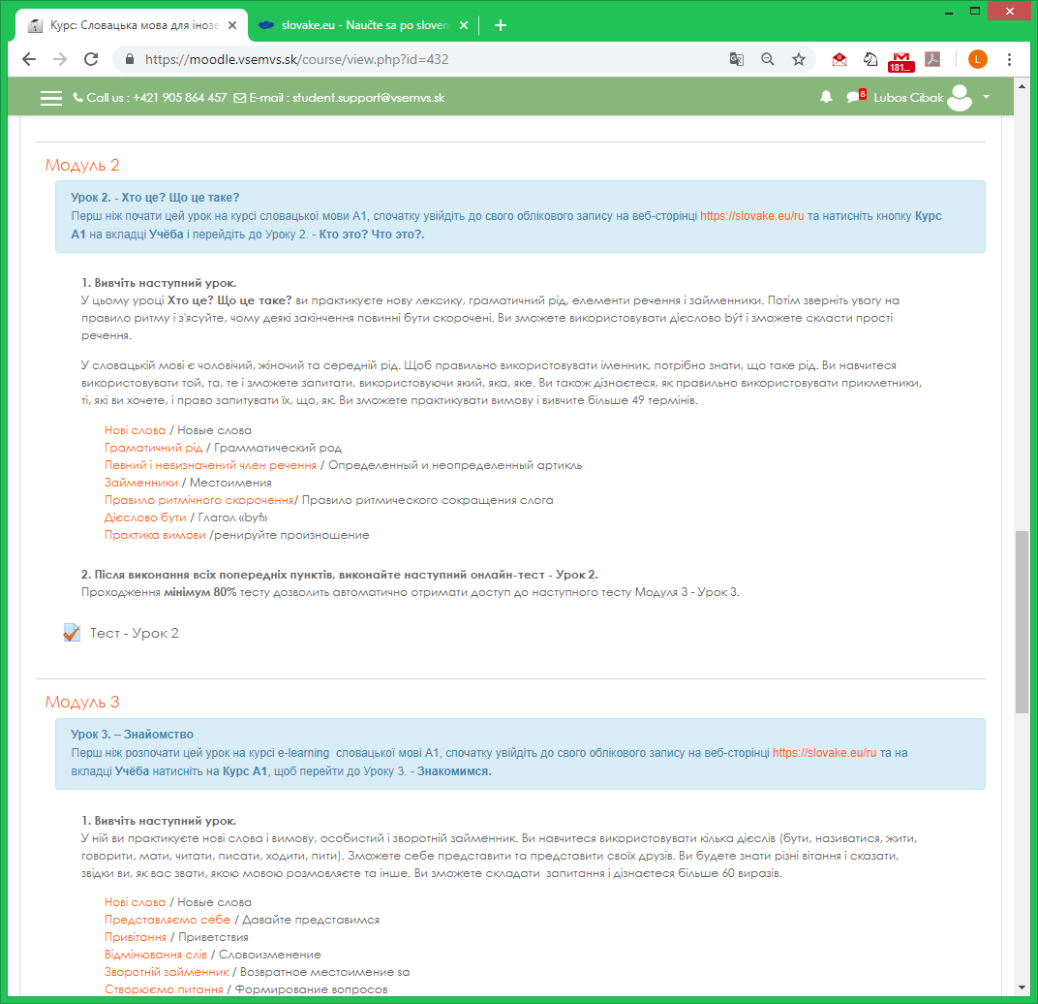
Slovak language courses

Slide 73
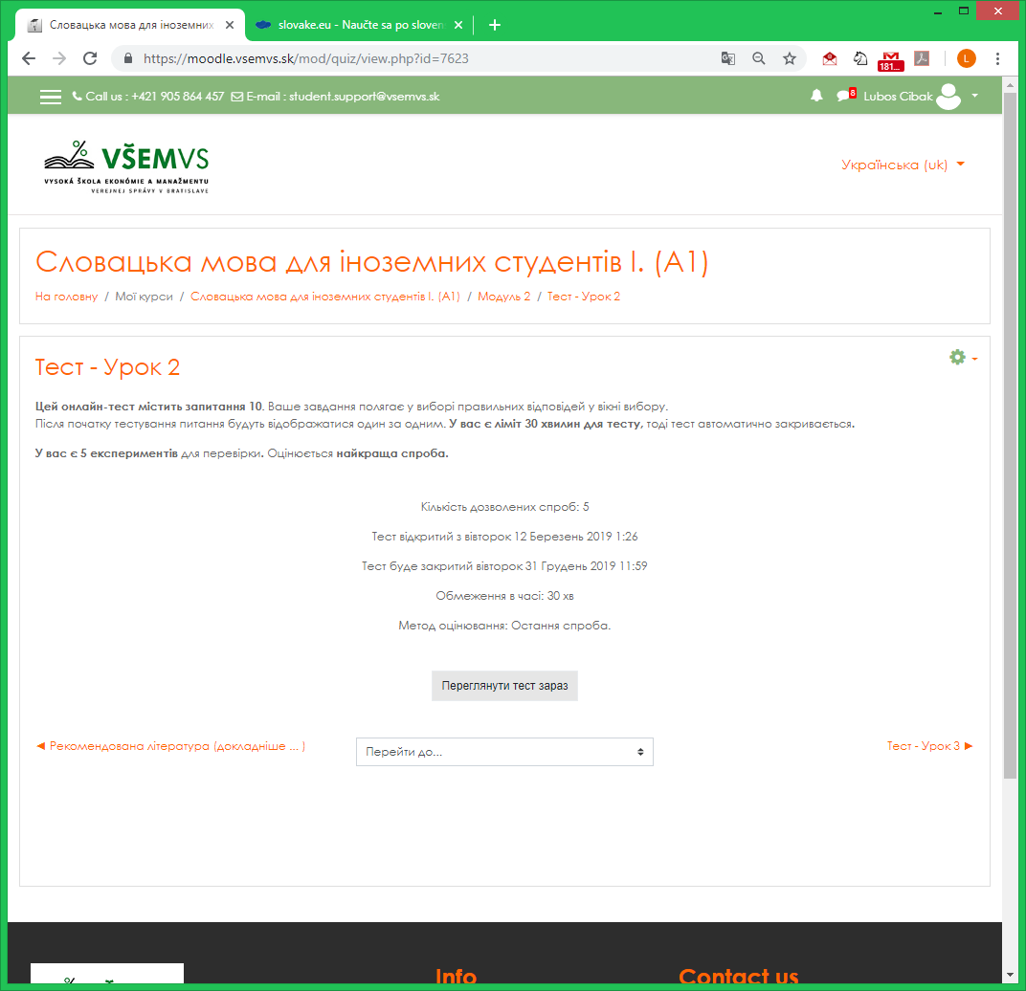
Slovak language courses

Slide 74
Otázky?
Questions?
Our Mission is your Success.
www.vsemvs.sk/en

Slide 75
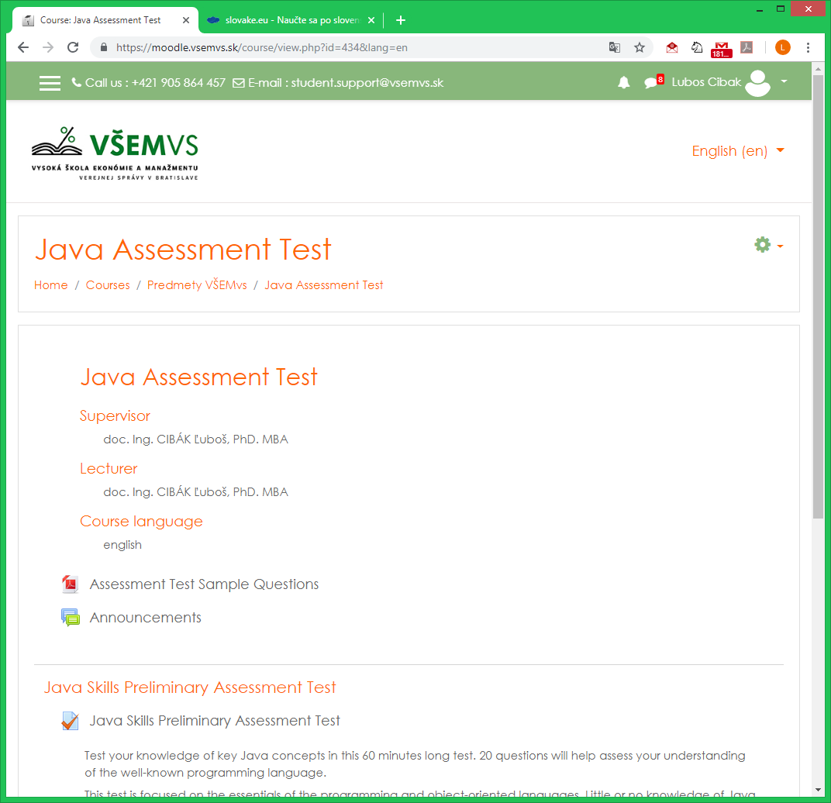
Java Assesment Test

Slide 76
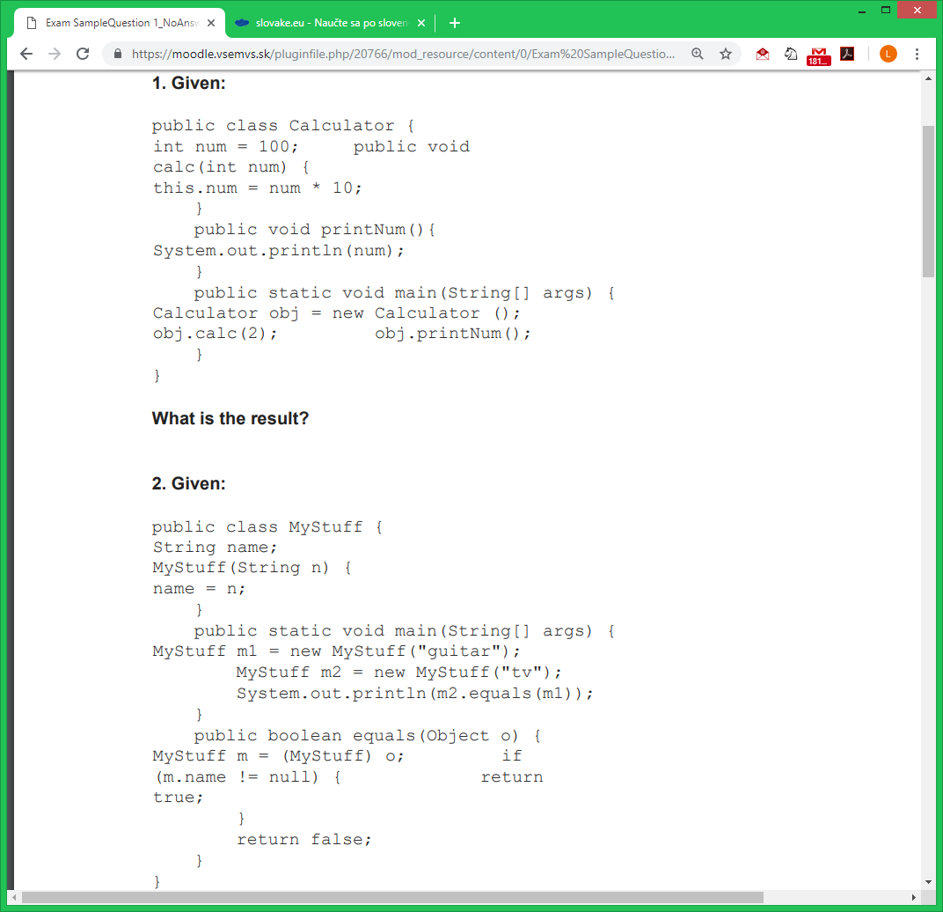
Java Assesment Test

Slide 77
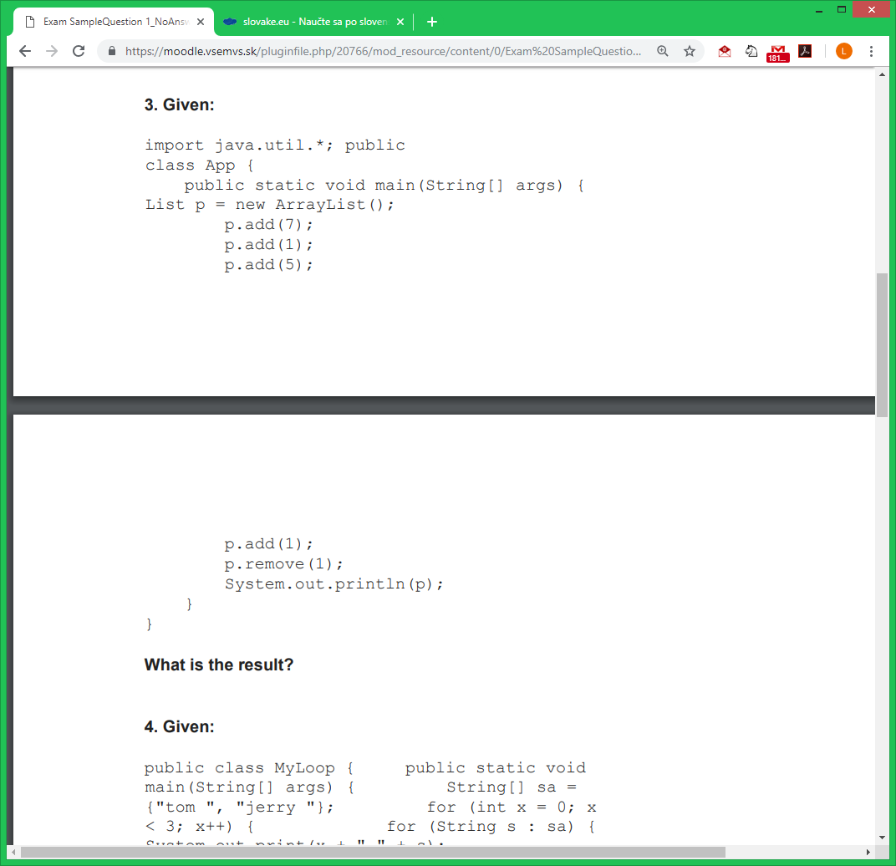
Java Assesment Test

Slide 78
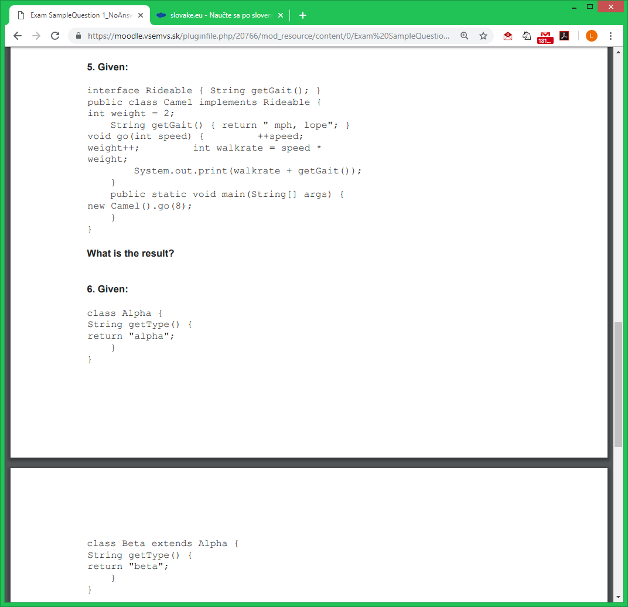
Java Assesment Test

Slide 79
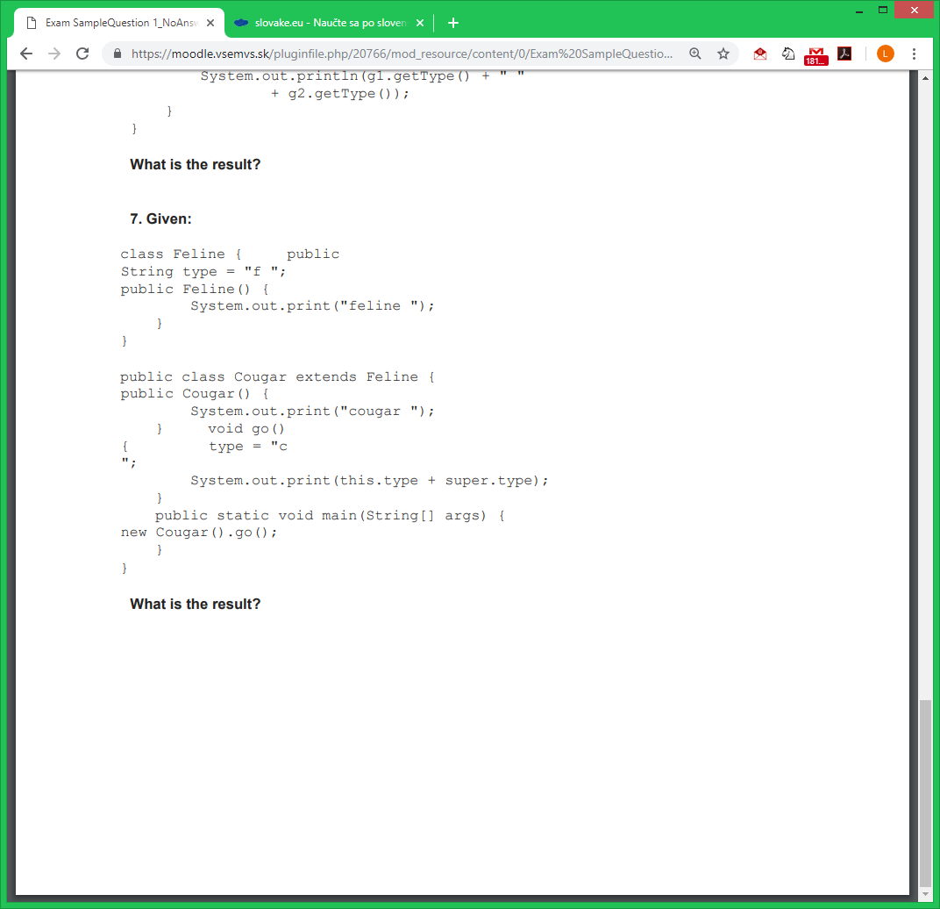
Java Assesment Test

Slide 80
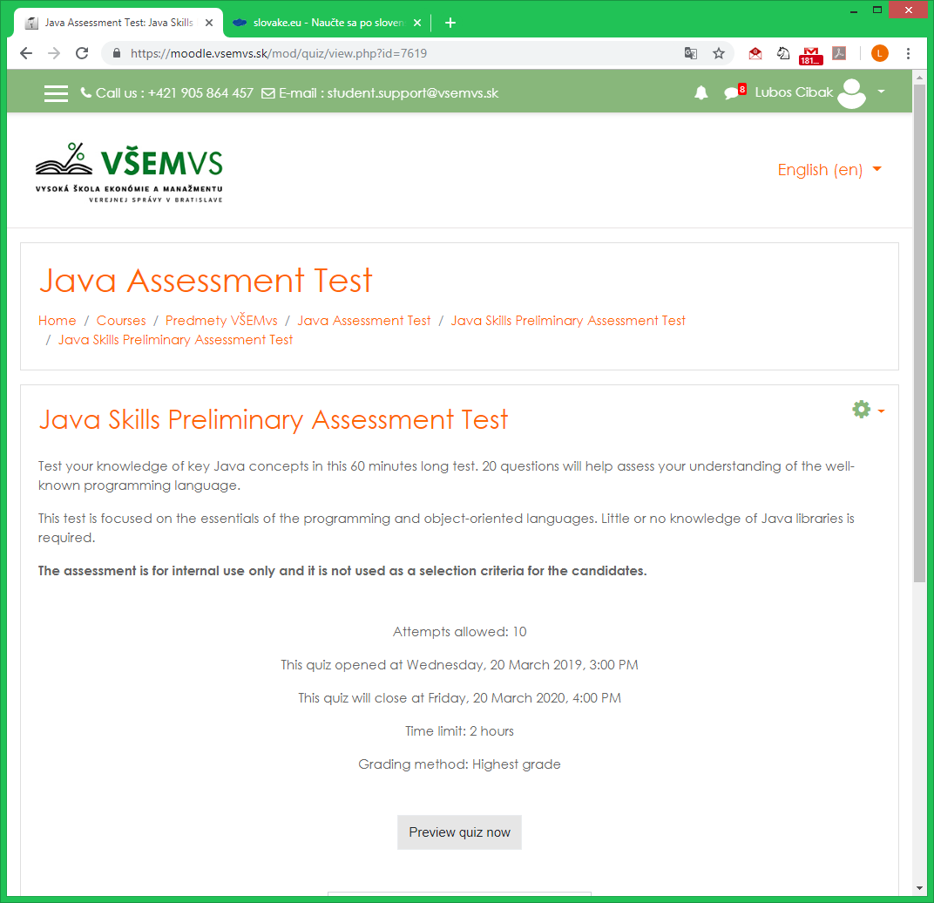
Java Assesment Test

Slide 81
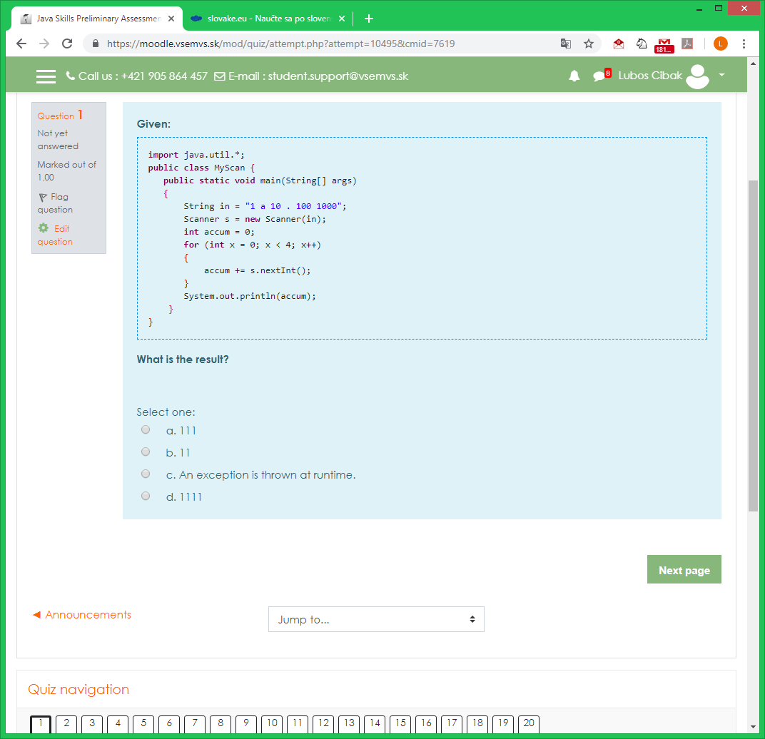
Java Assesment Test

Slide 82
Otázky?
Questions?
Our Mission is your Success.
www.vsemvs.sk/en

Slide 83
Ďakujeme za pozornosť
Thanks for Your Attention!
Our Mission is your Success.
www.vsemvs.sk/en

